Slide 1
IEEE Project Competition
Week 4: Intro to KiCad

Slide 2

Sign-in Form

Slide 3
Finalized Teams
Electric Skateboard (Mini) - Beginner | Block Moving Robot - Advanced | Audio Visualizer - Beginner (individual) | Arcade Game - Advanced (individual) | Floating Magnet - Beginner (Individual) | Batmobile - Beginner | LED Pitch Changer - Beginner | Climbing Robot - Beginner | Mobile Game - Beginner | Knightboy- Advanced
Evan Eichholz, Bree | Eric Segrest, Abdiel, Mike (maybe) | Alexander | Aldem | Joshua Guo | Amy Diaz, Liani Garcia, Jennifer | Landon Luke, Ryan Moran, Samuel Hustin | Viviana, Frankey, Rolando, Keya | Joshua, Jacob, Jason | Scott …
Airpodsred, breemars56 | MrE9000, thebackdimple , _dasanii | limes1 | syndric | tallasian0281 | Tedpluto, lenedinal | Landonluke, rmoran24 | LanceEvo,Madeem, amnotkt | Espial7, Funnmy, jasr321 | .planky.

Slide 4
Reminders
Check Discord we now have created personal project group chats.
Please make sure to have a computer and mouse on hand, trackpad is fine.
If you have questions about team roster DM or we will talk after class.
Workshop will be centered around one PCB.
General structure for today:
What is KiCad -> Install -> Schematic -> Footprints -> PCB View -> Final

Slide 5
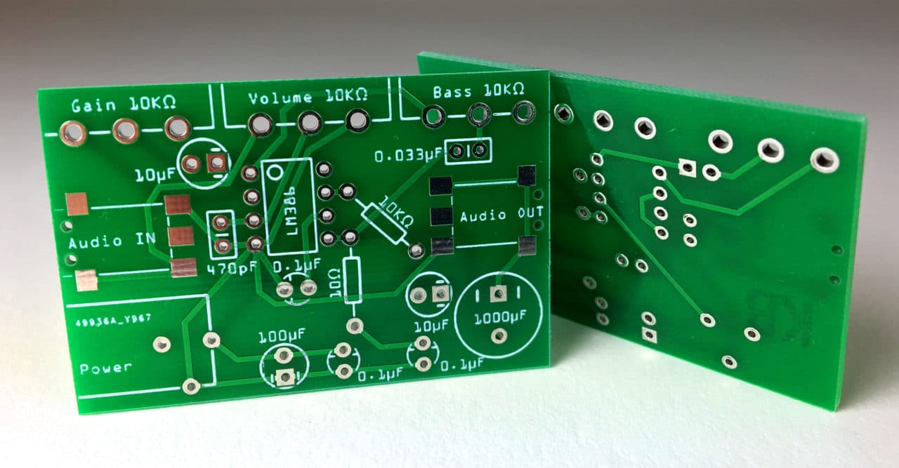
What is PCB design?
Printed Circuit Board
Designing the layout of electronic circuits on a board
Connects various components via conductive pathways, signal traces
Importance:
Central to all electronic devices
Determines performance, reliability, and manufacturability
Steps in PCB Design:
Schematic Capture
Component Placement
Routing the Traces
Testing and Simulation

Slide 6

What is KiCad?
What is KiCad?
KiCad is a full featured software suite for the production of PCBs
Key Features:
Free and Open Source Software (FOSS)
Works on Mac, Windows, and Linux
Schematic Capture, PCB Layout, and 3D Viewer
Who Uses KiCad?
Engineers
Designers
Educators and Students
Hobbyists

Slide 7
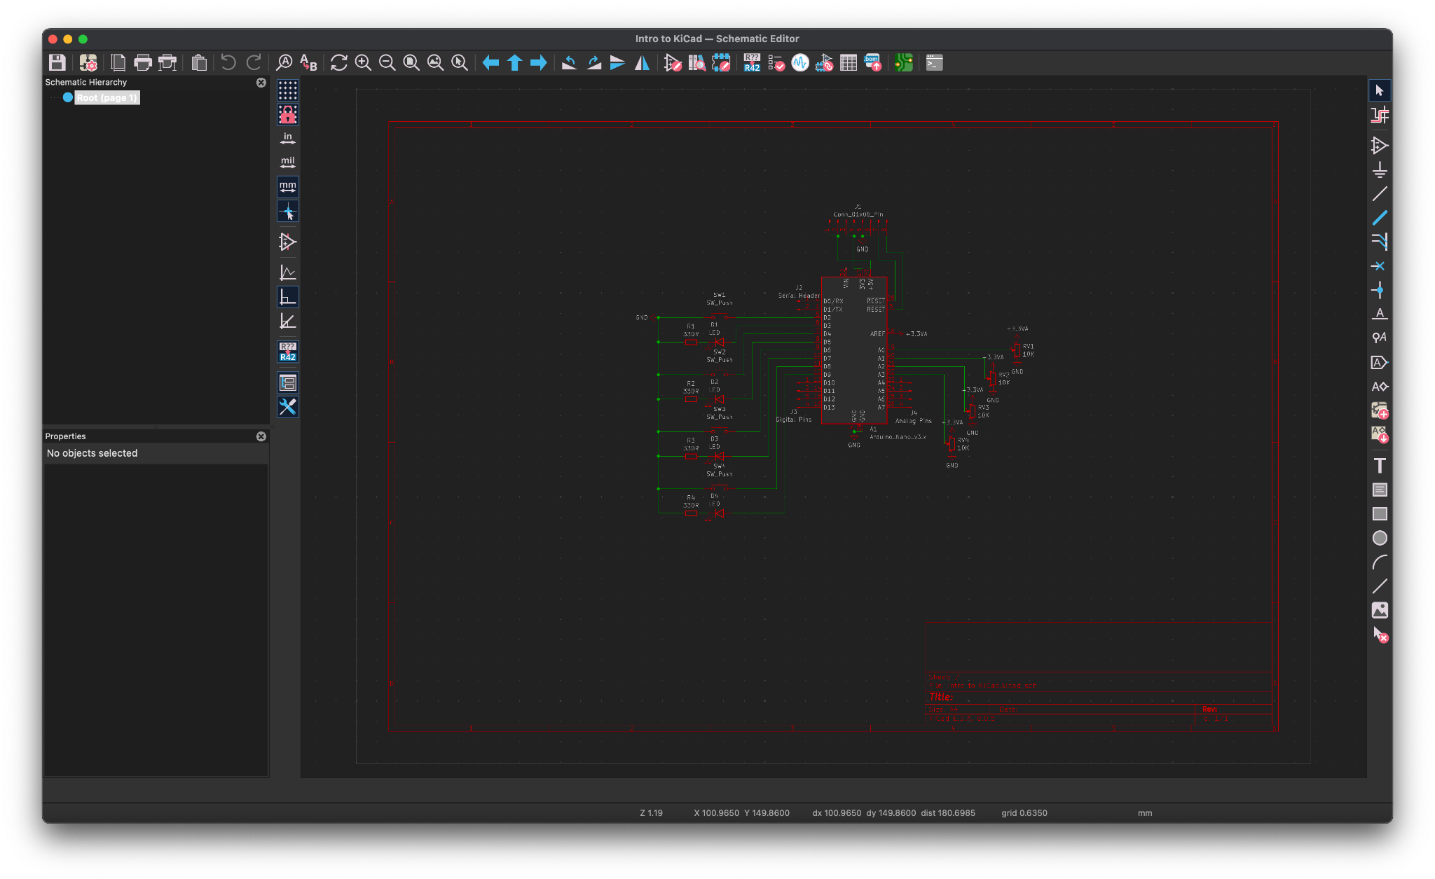
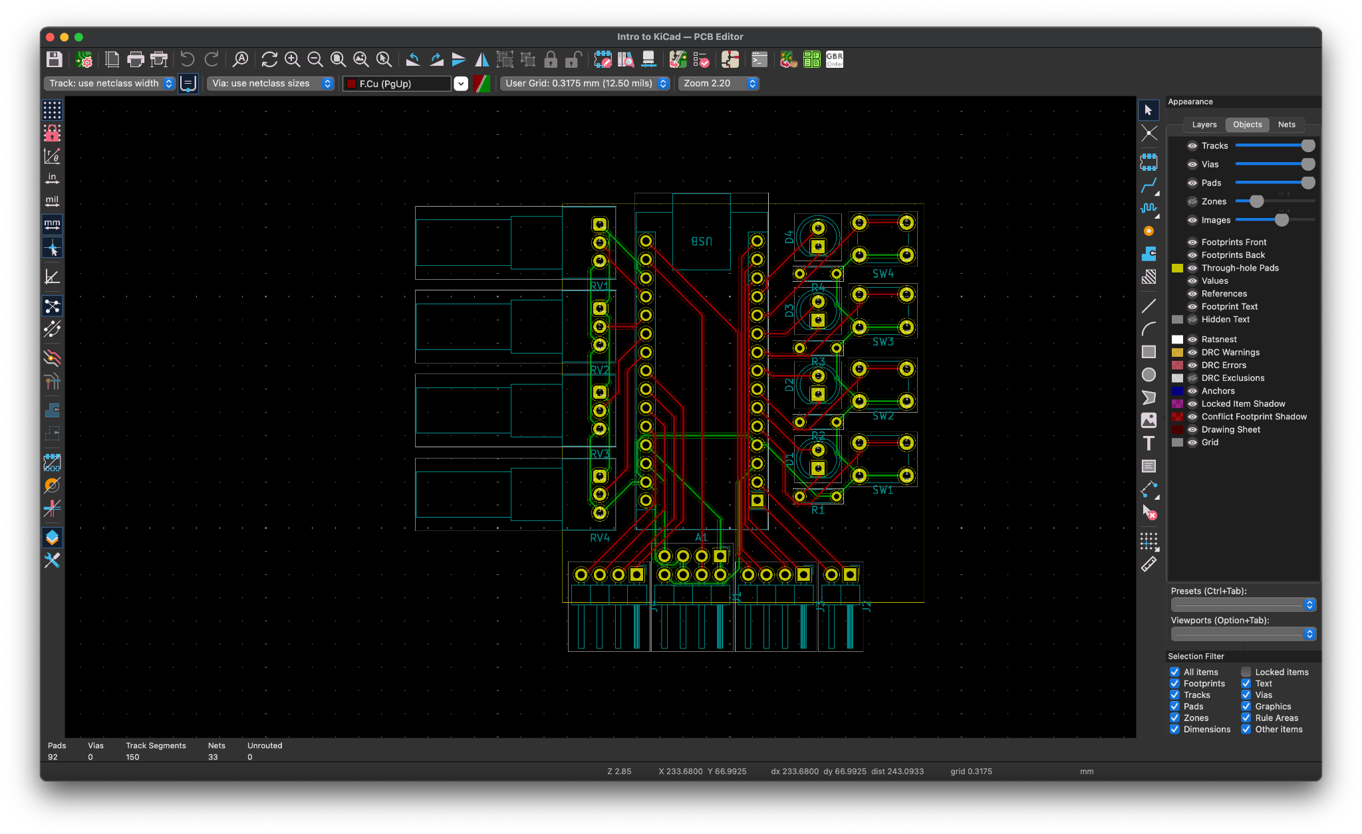
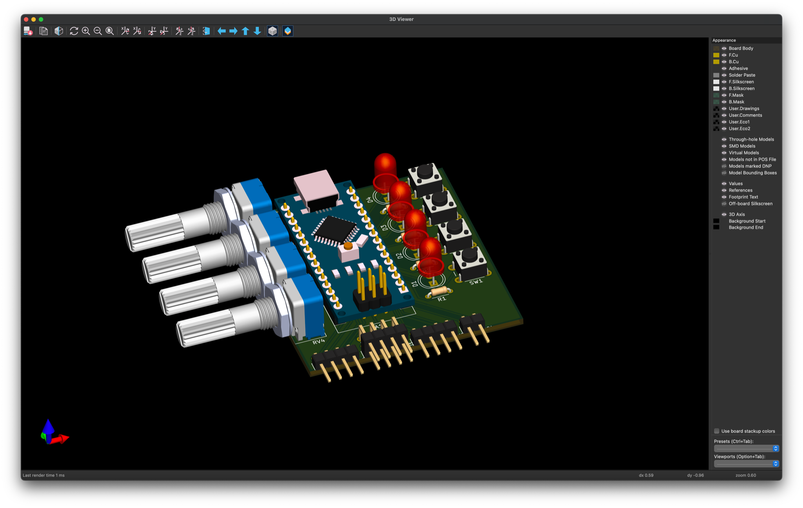
KiCad
Main Features:
Schematic Editor: Create schematics from built in parts libraries
PCB Editor: Convert the schematic into a PCB
3D Viewer: View preview of populated PCB
Advanced Features:
Symbol Editor: Create or edit components for schematic
Footprint Editor: Create or edit components for PCBs

Slide 8

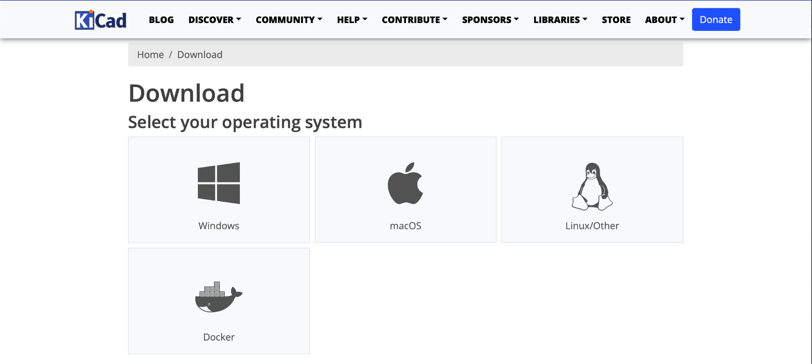
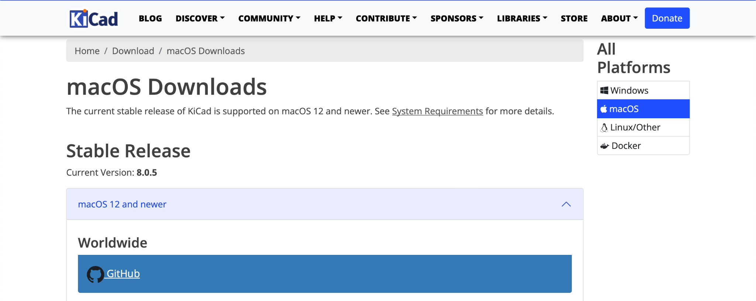
How to Download KiCad
Go to https://www.kicad.org/
Click Download
Select your operating system
Download from worldwide for your OS version

Slide 9
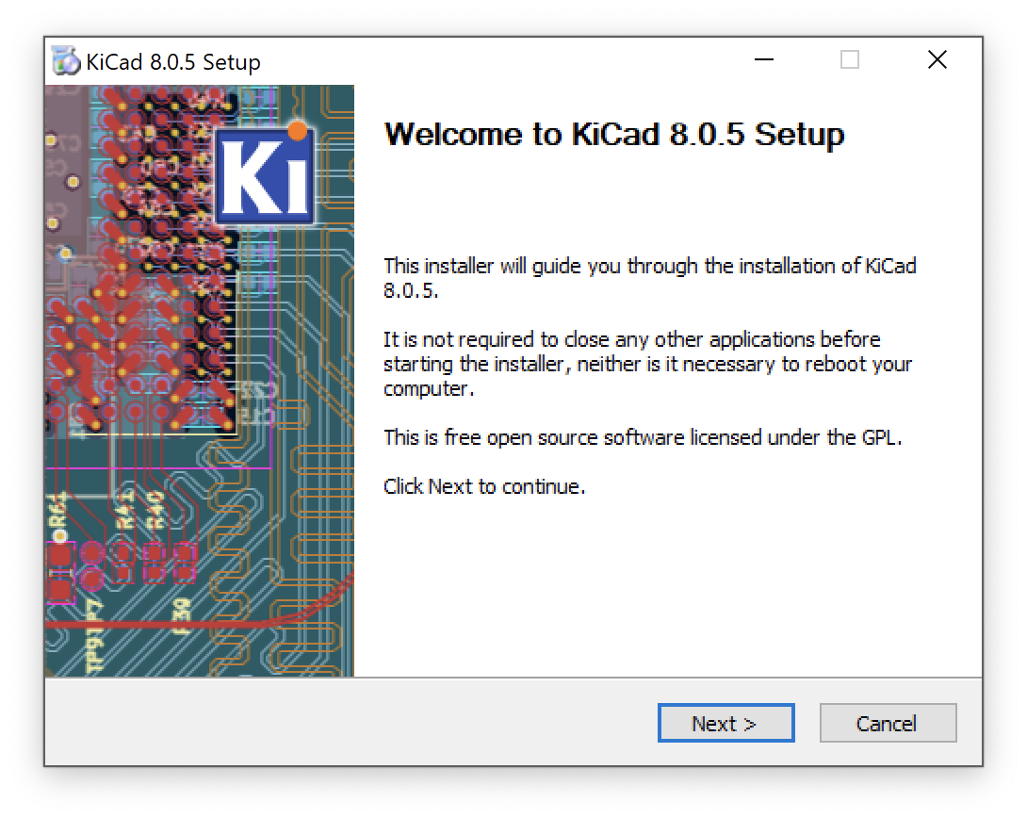
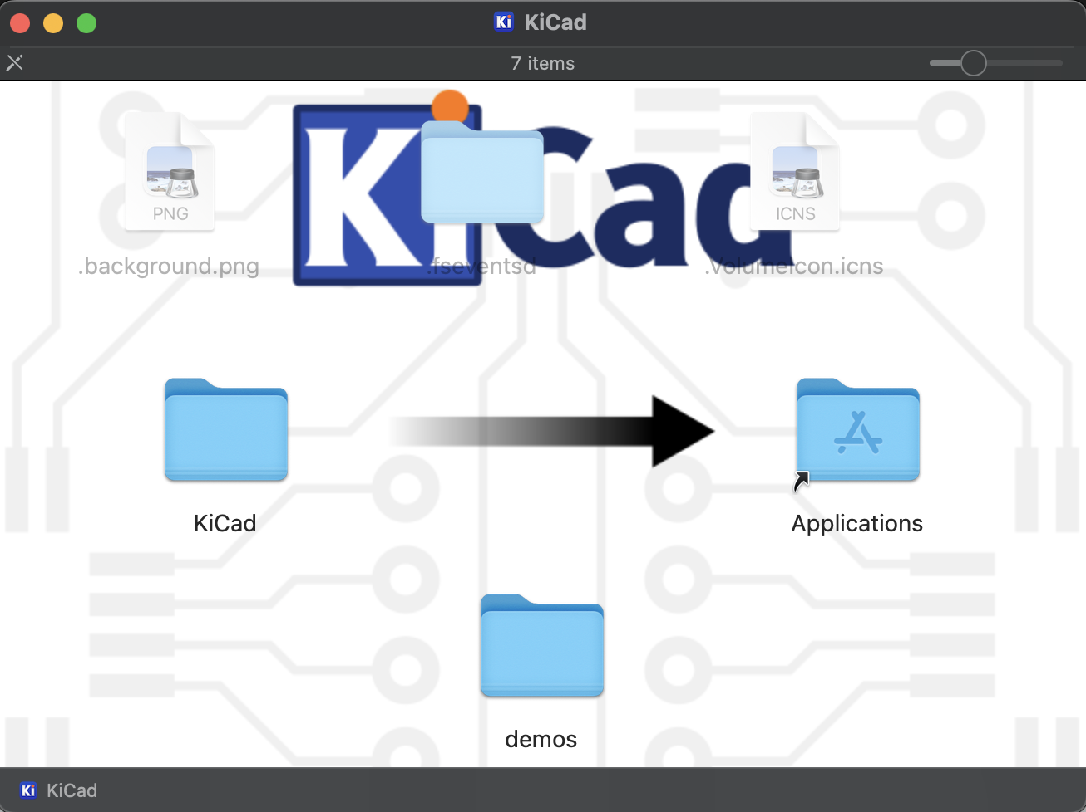
How to Install KiCad
For Mac
Open the DMG file
Drag the KiCad folder into the Applications folder shortcut
For Windows
Open the EXE file
Follow the on screen instructions to complete install

Slide 10
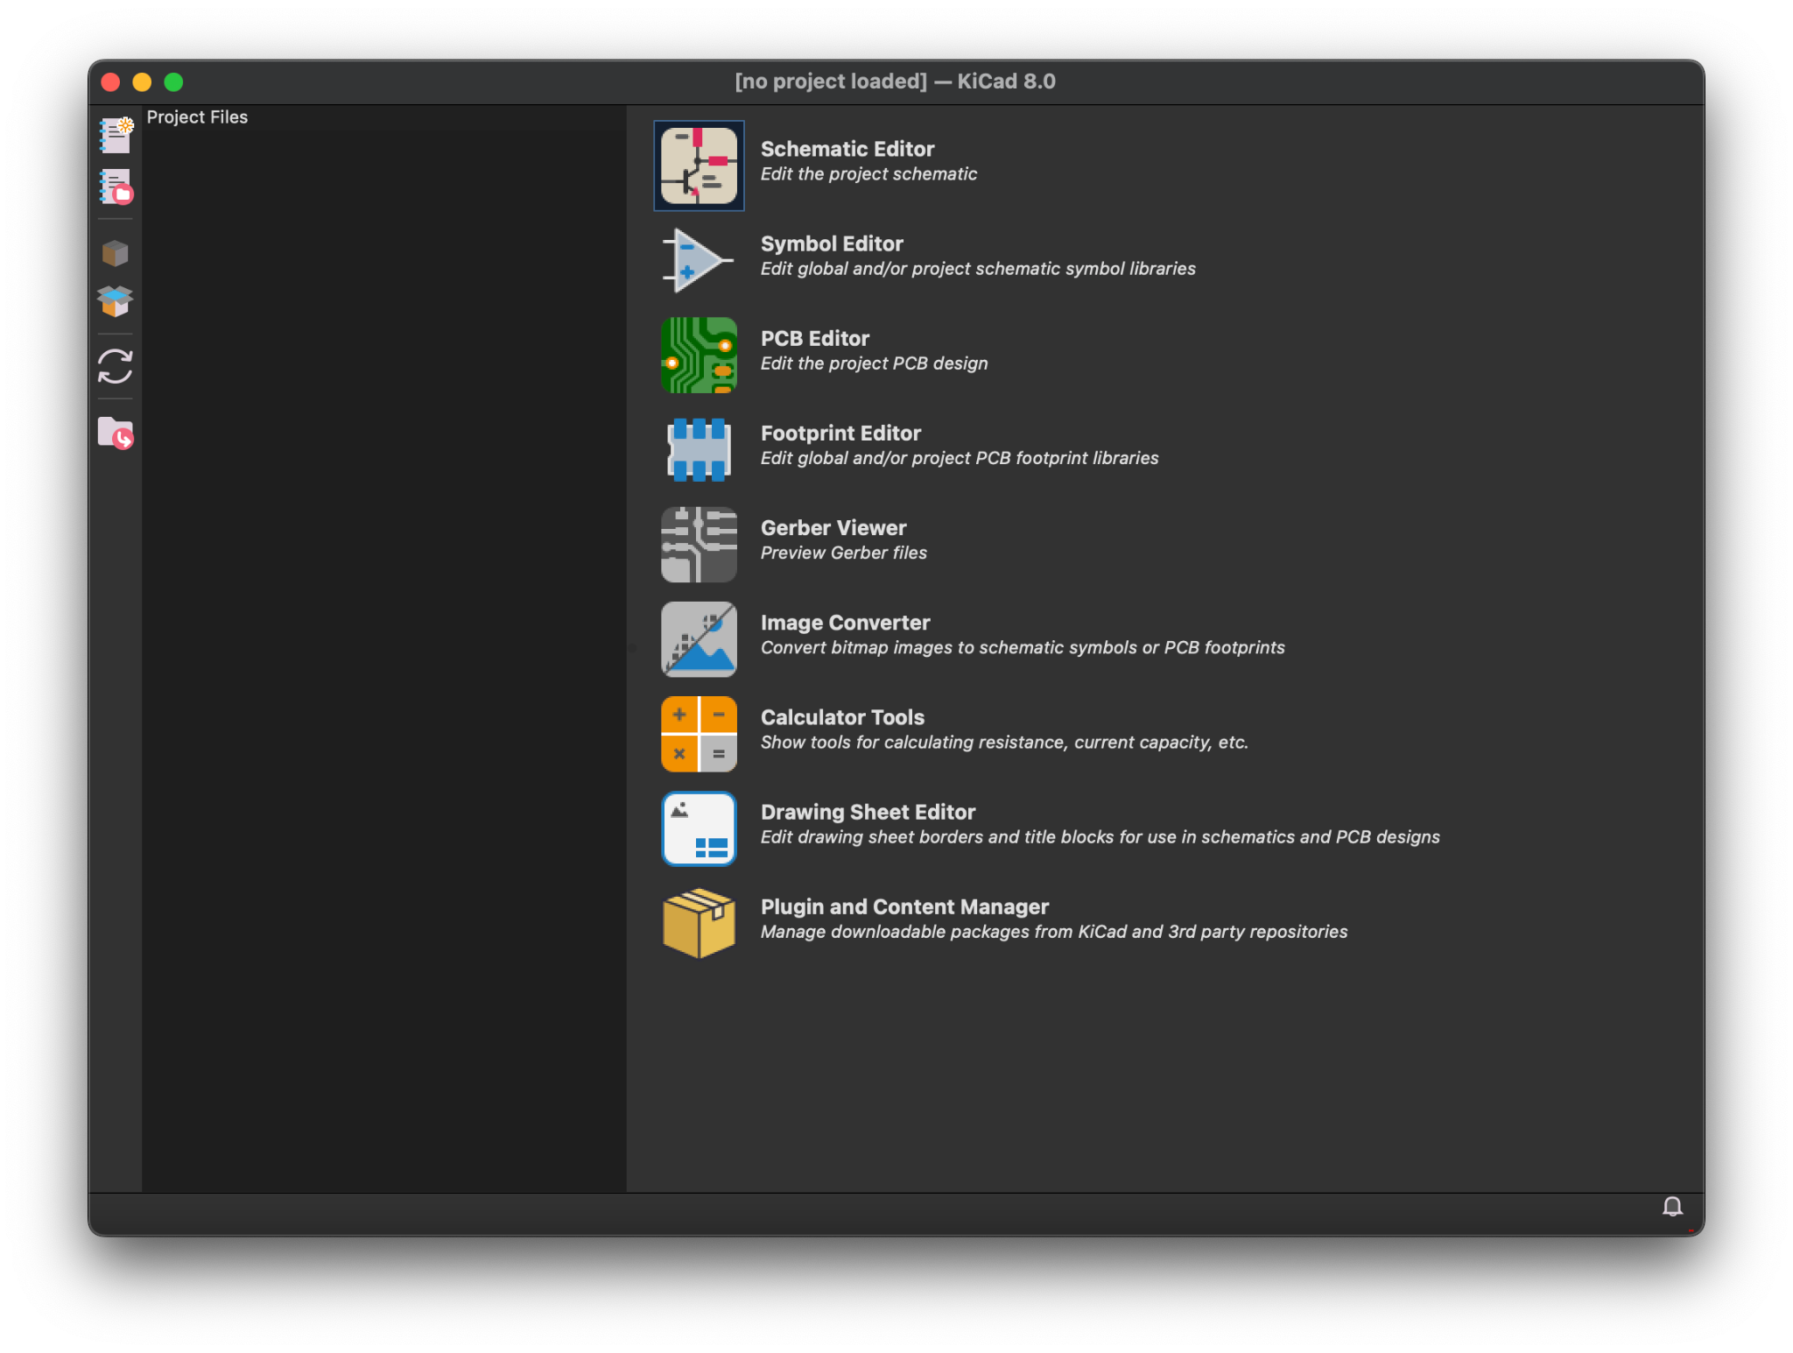
Creating your first project
Click the New Project button in the top left
Choose a location and a name to save your project under

Slide 11
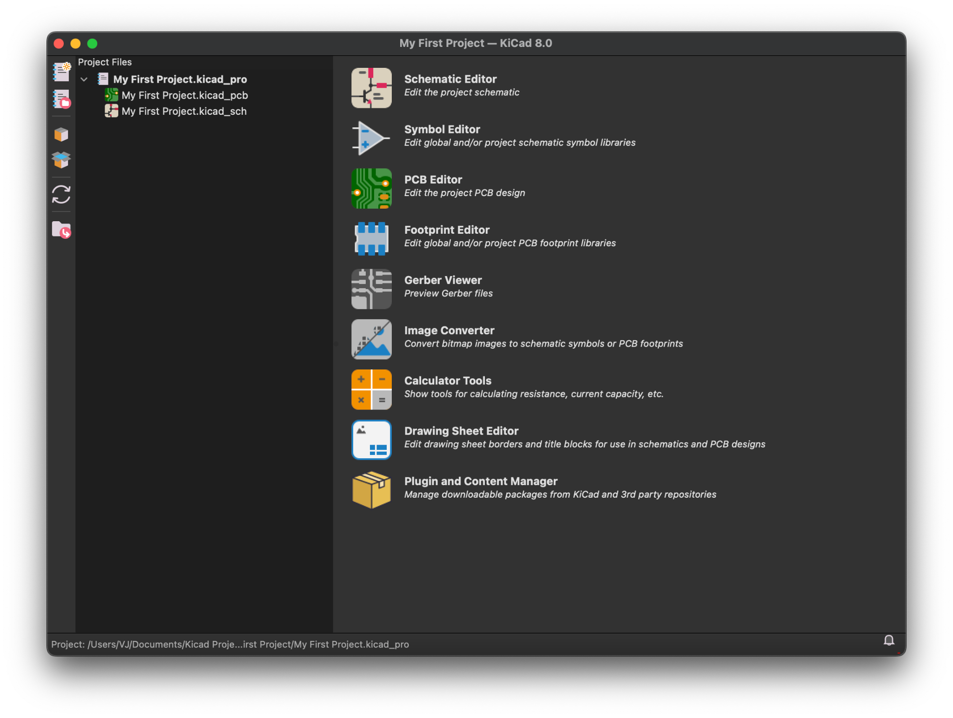
Creating your first project
You now have a project to work under
To get started click the Schematic Editor button

Slide 12
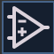
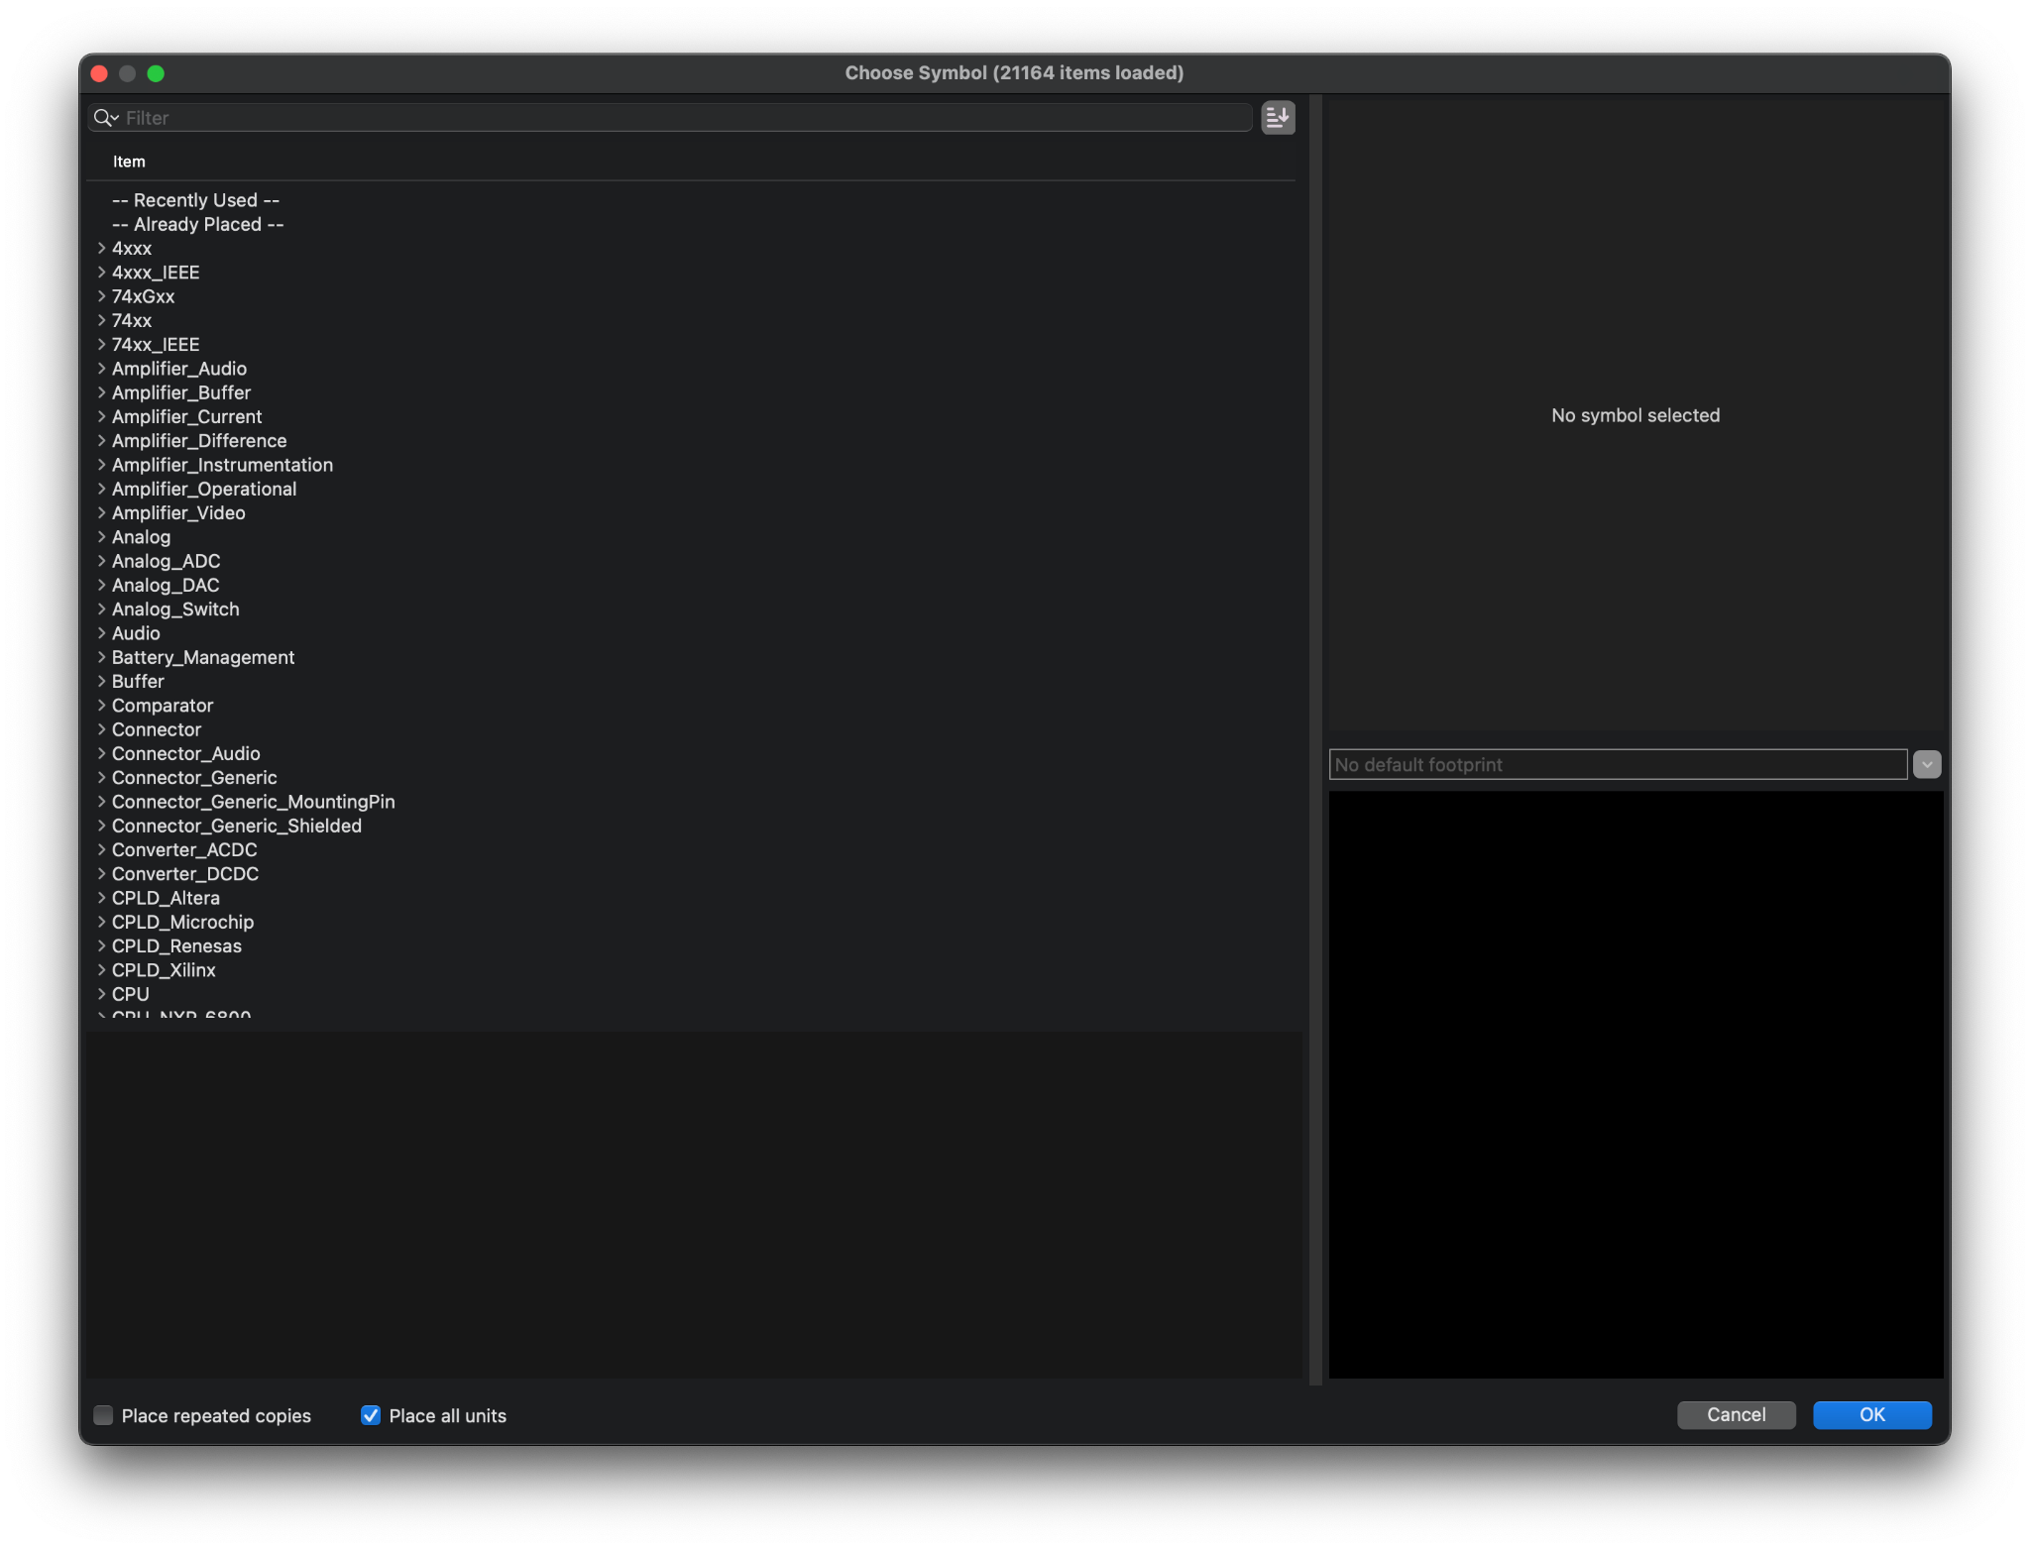
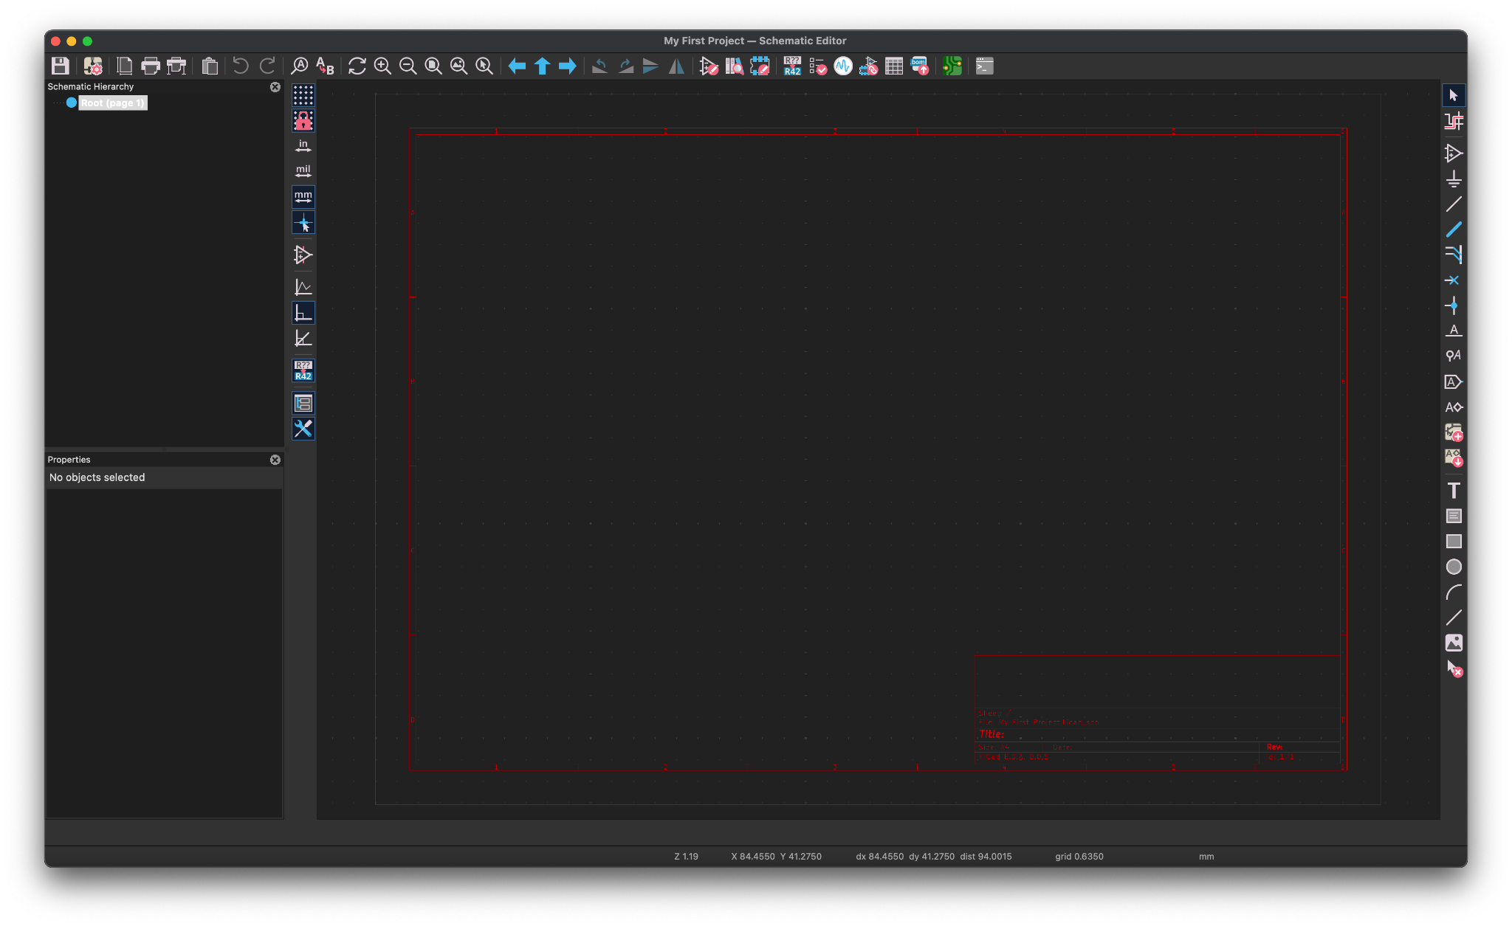
Creating your first schematic
To get started you will use the Add Symbol tool (A) in the right toolbar

Slide 13
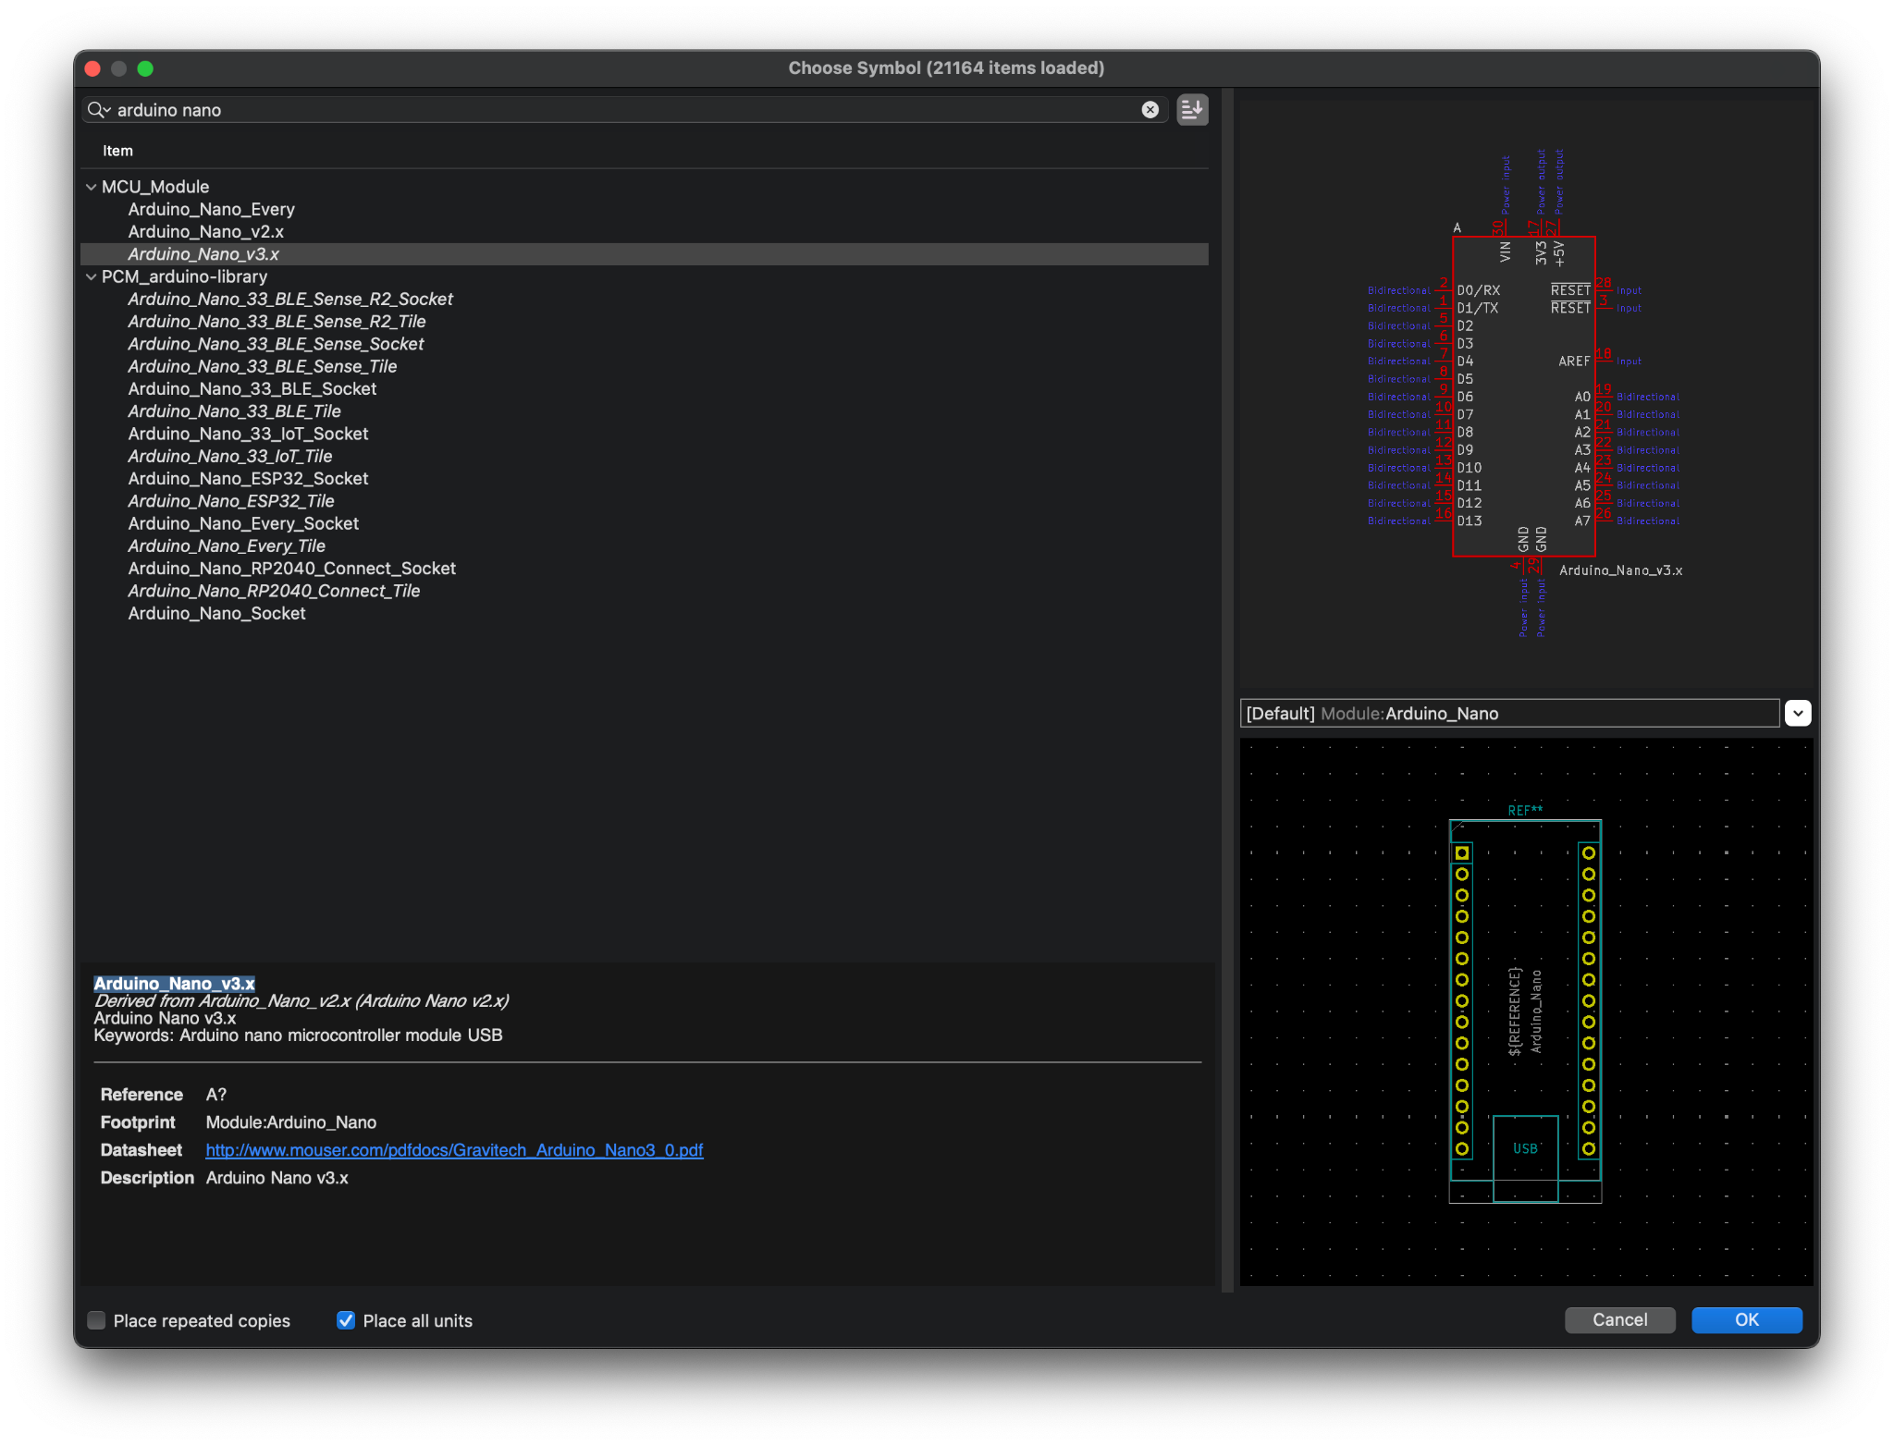
Creating your first schematic
First symbol to place, search for arduino nano

Slide 14
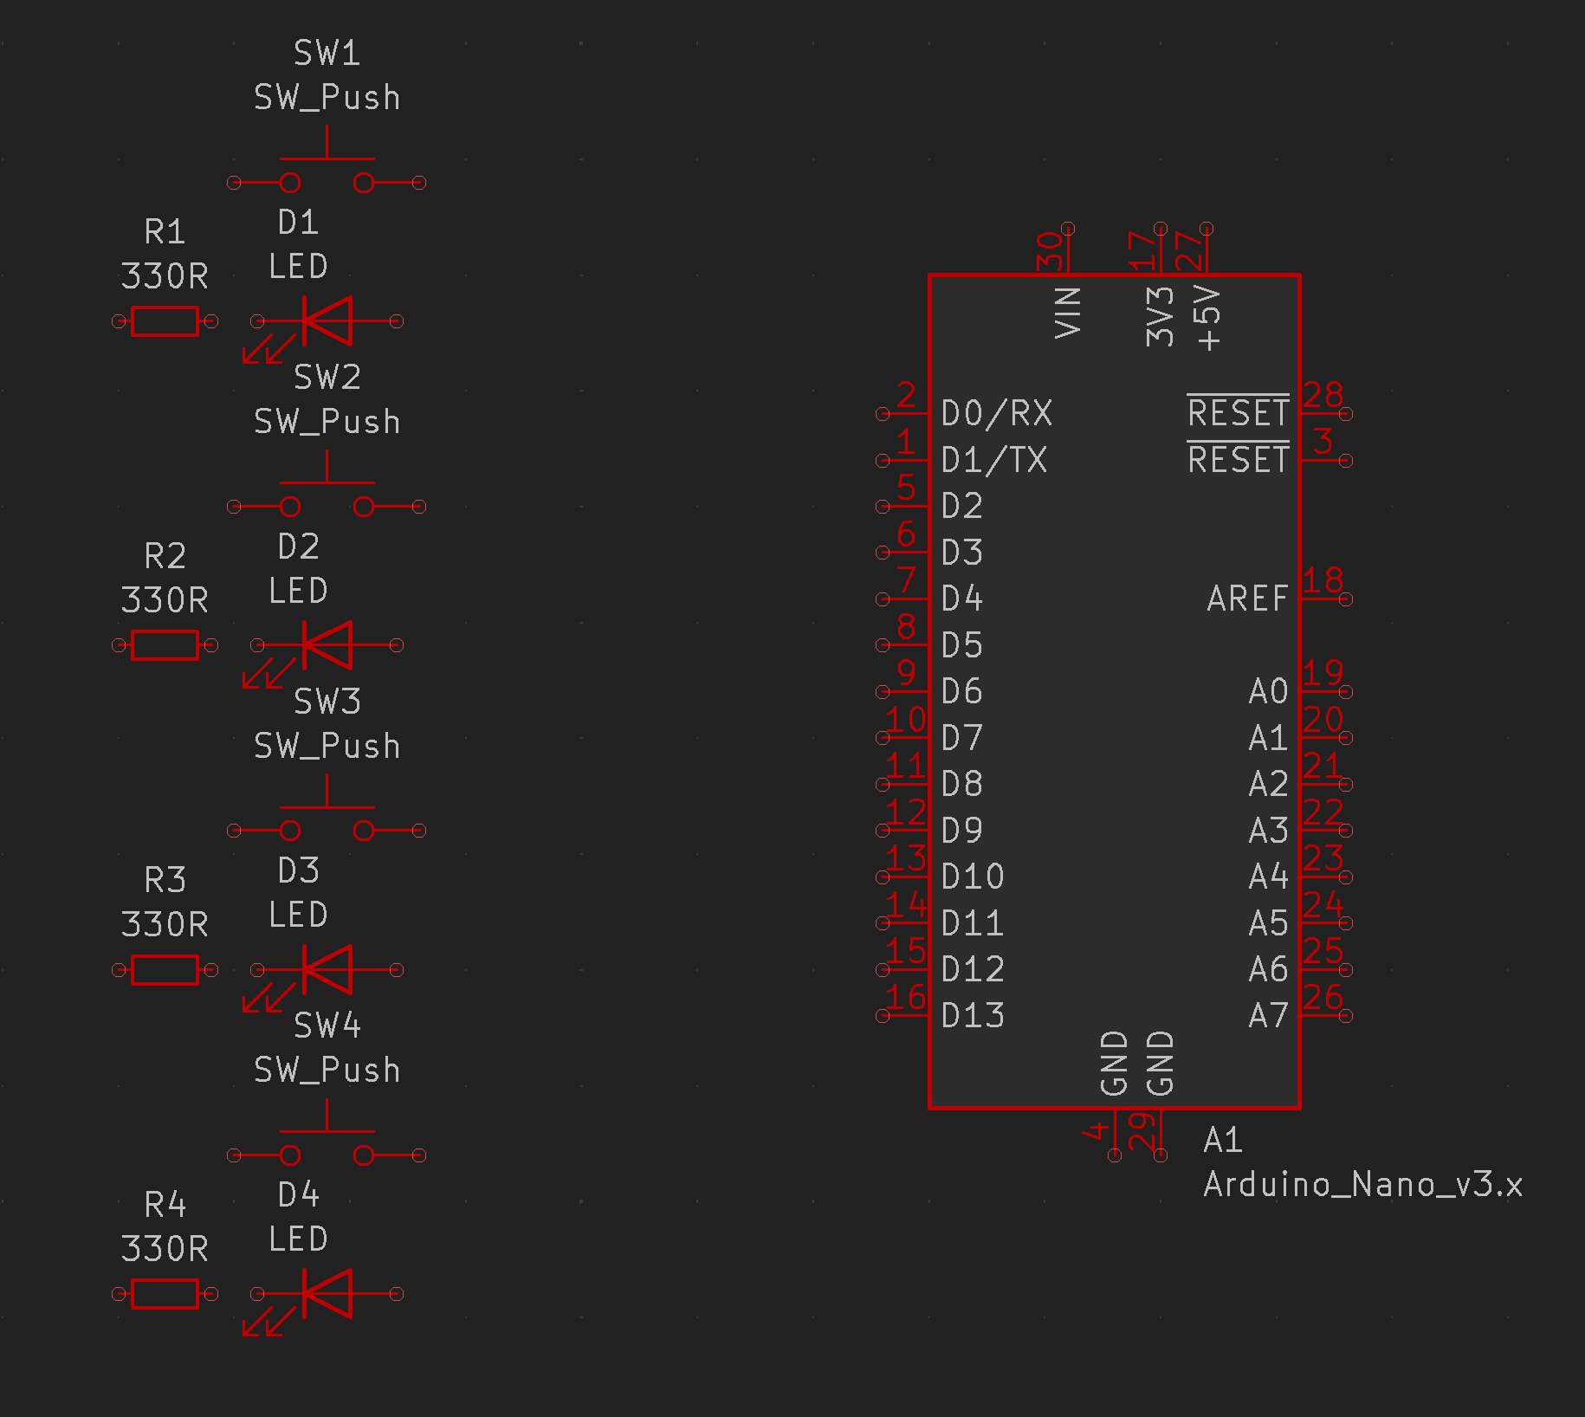
Creating your first schematic
Keep using the Add Symbol tool (A) to add more components, along with copy and paste
Add 4 resistors, 4 LEDs, and 4 push buttons
Hover over a symbol and press V to Edit the Value Field

Slide 15

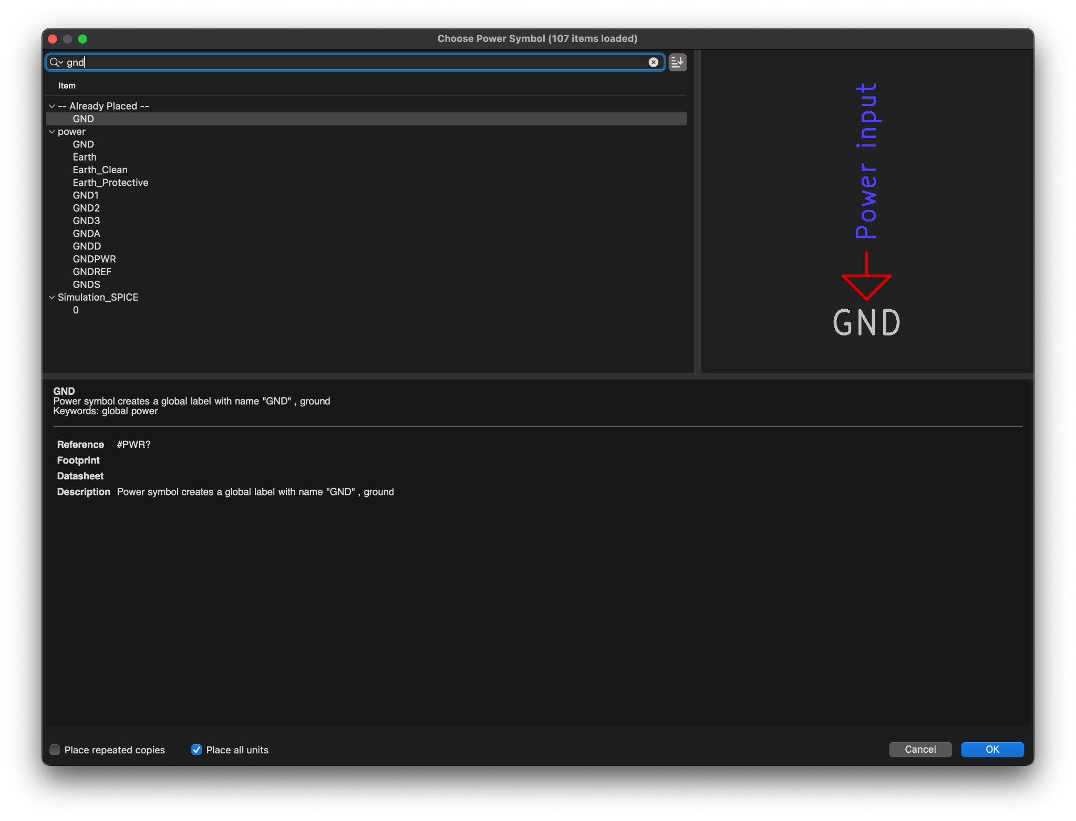
Creating your first schematic
Use the Add Power tool (A) and search for gnd to add ground symbols

Slide 16
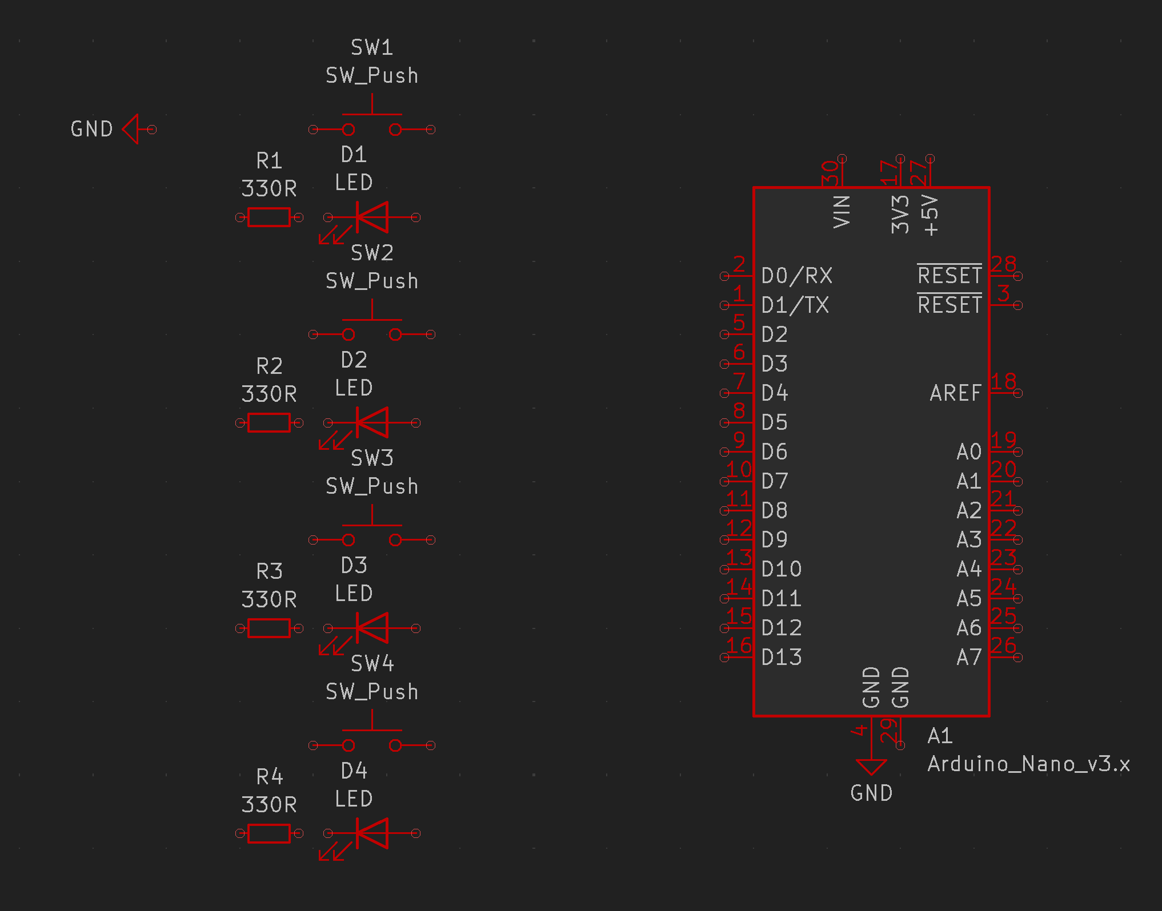
Creating your first schematic
You can place more than one and they will automatically be connected to each other

Slide 17

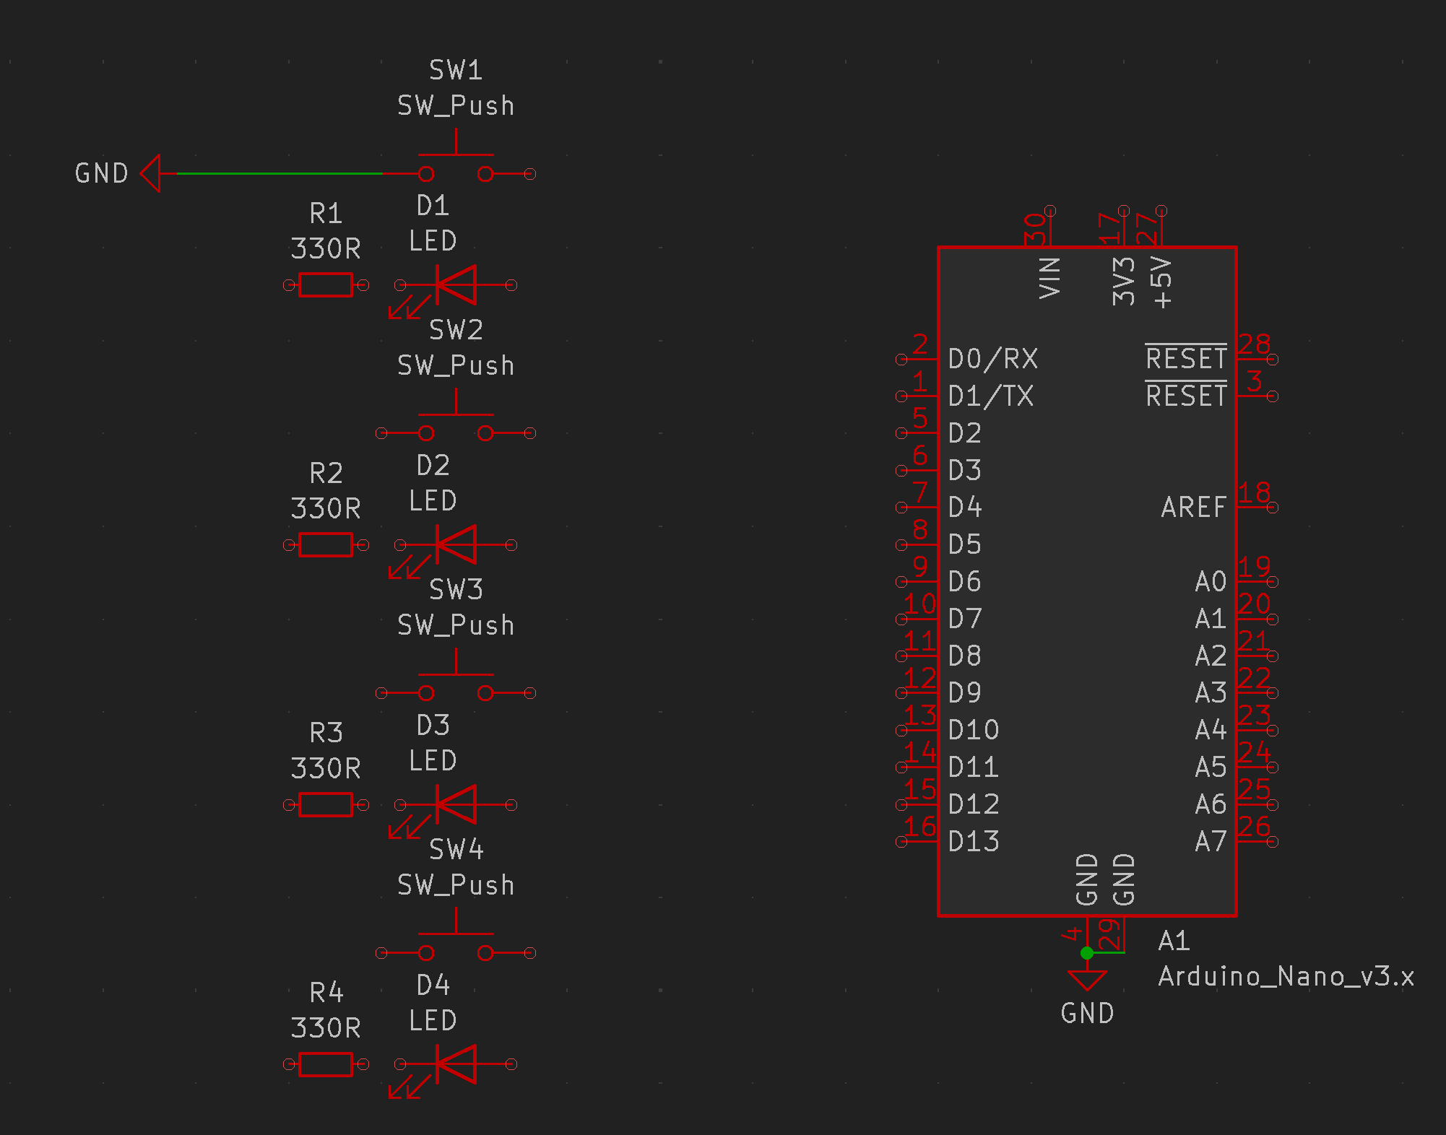
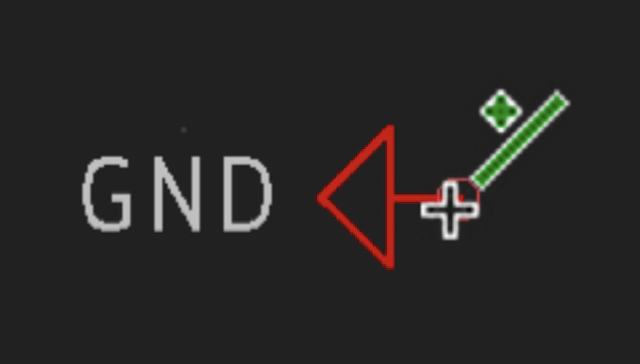
Wiring your first schematic
You are now ready to connect your schematic together
Use the Add Wire tool (W) or hover over the tiny circle on a component to draw wires when this symbol appears

Slide 18
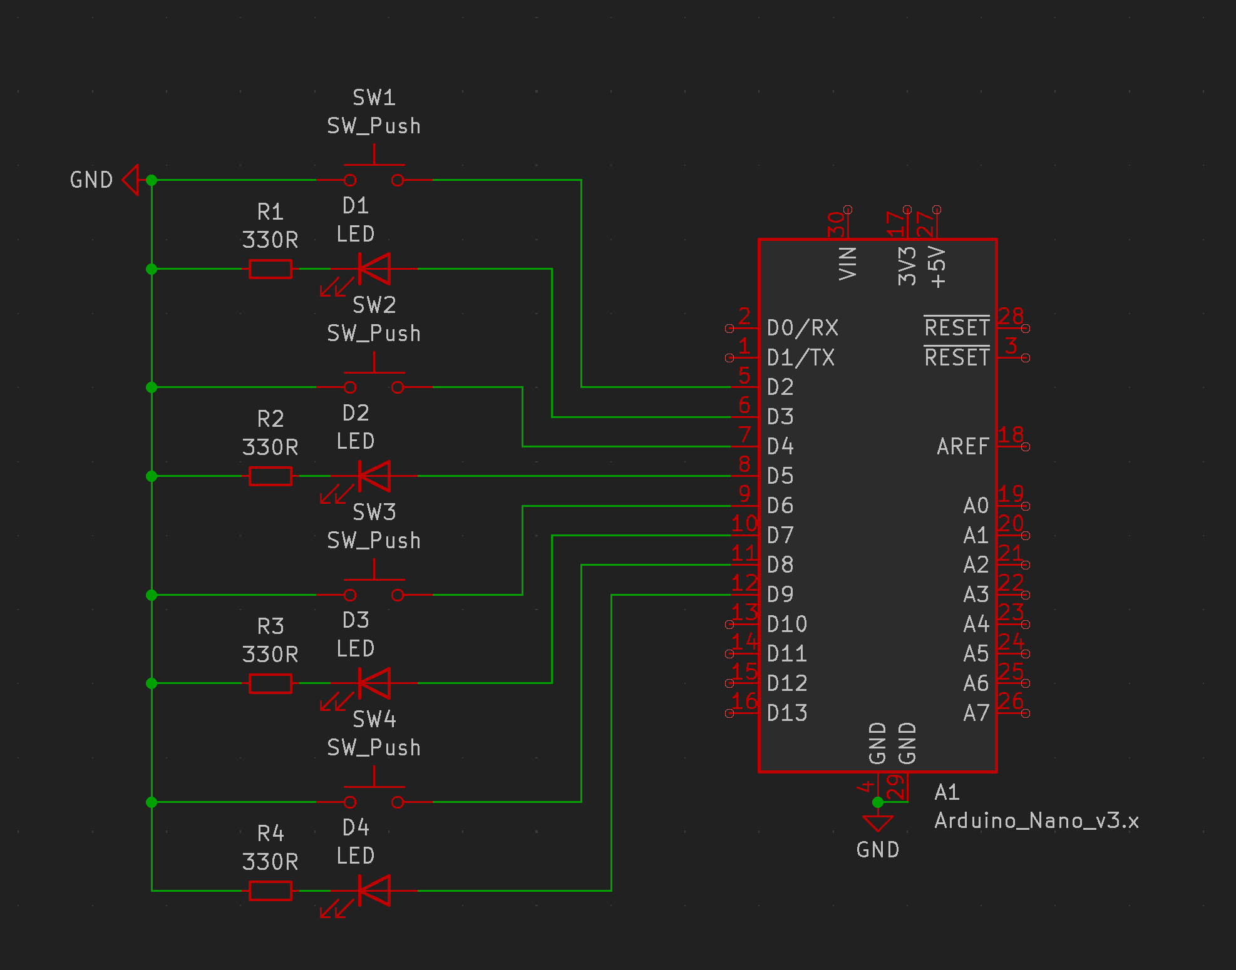
Wiring your first schematic
Continue to wire the entire schematic

Slide 19

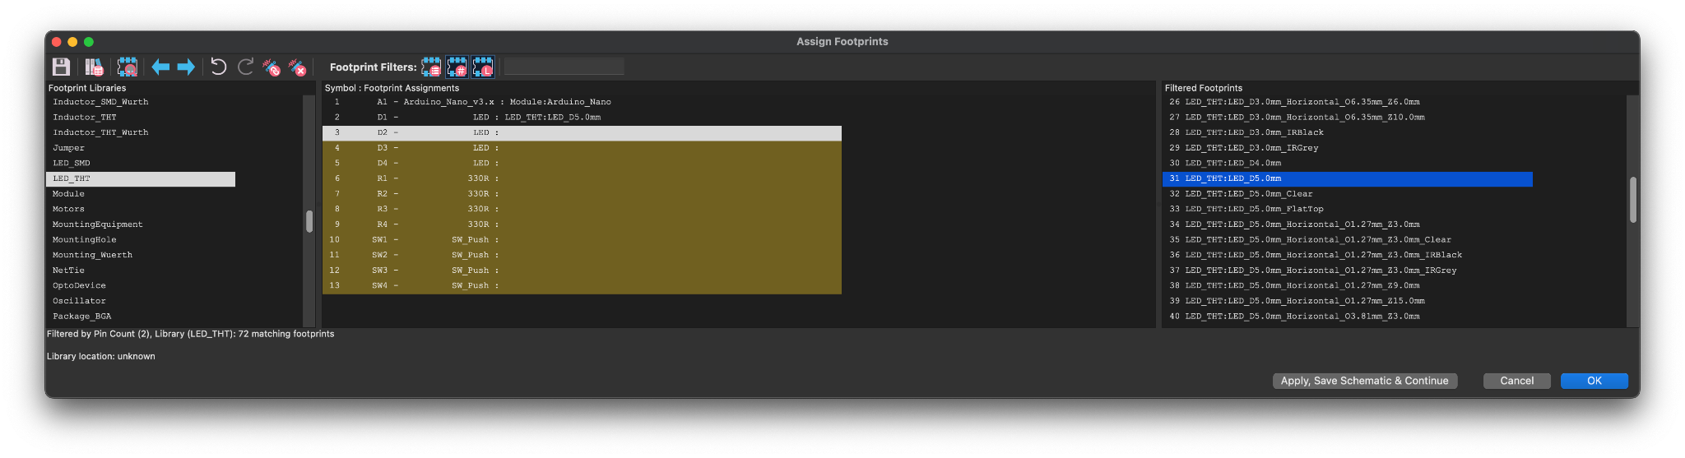
Finishing your first schematic
Now you will use the Assign Footprints tool in the top toolbar
Use this to assign the actual components you will be using to their corresponding schematic symbol

Slide 20

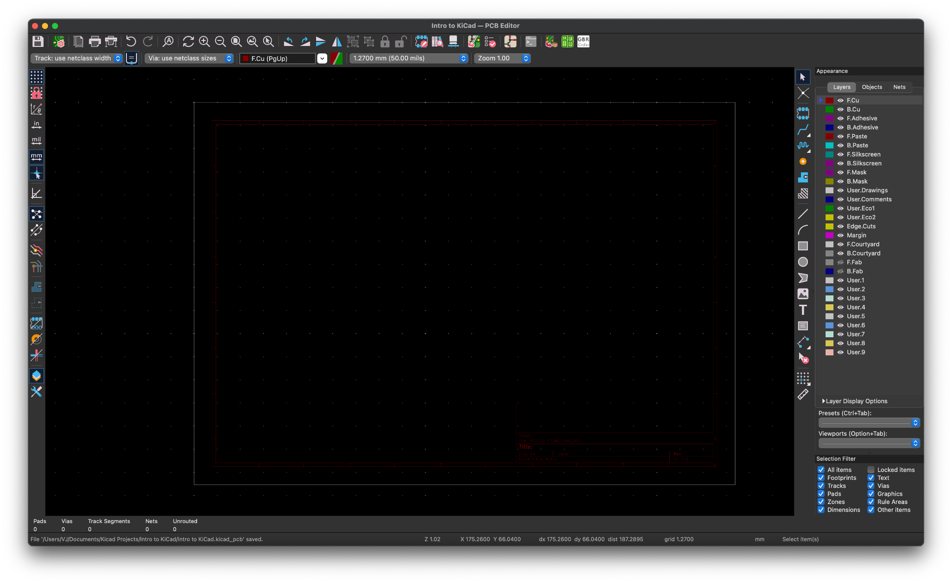
Creating your first PCB
Click the switch to PCB Editor button in the top toolbar to open the PCB Editor

Slide 21
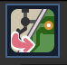
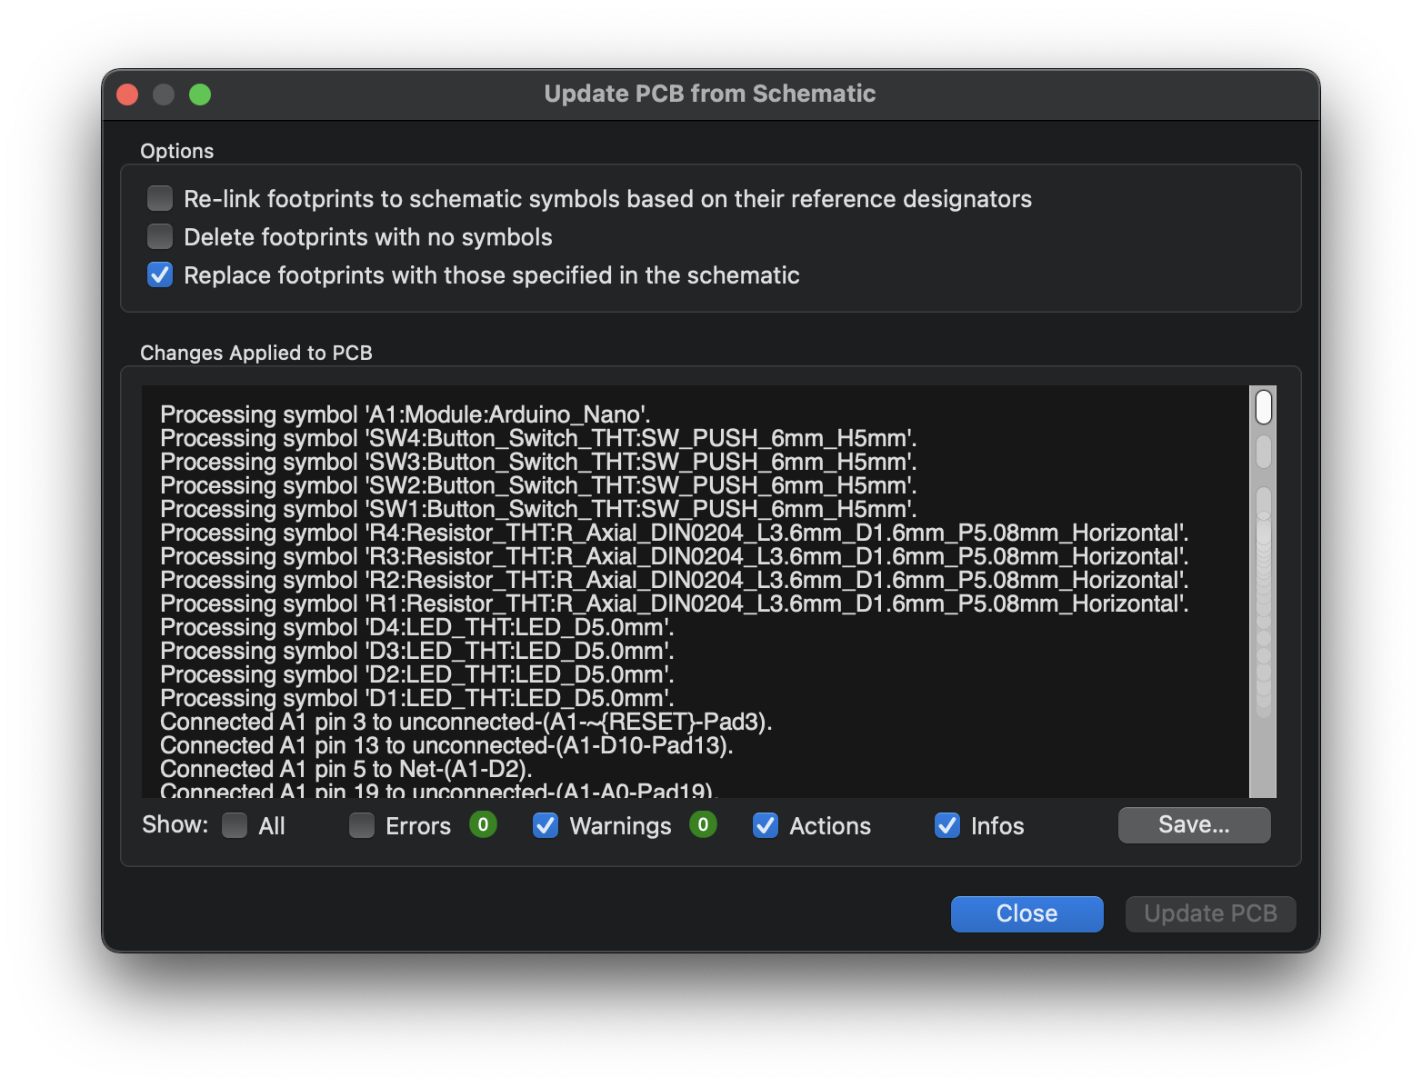
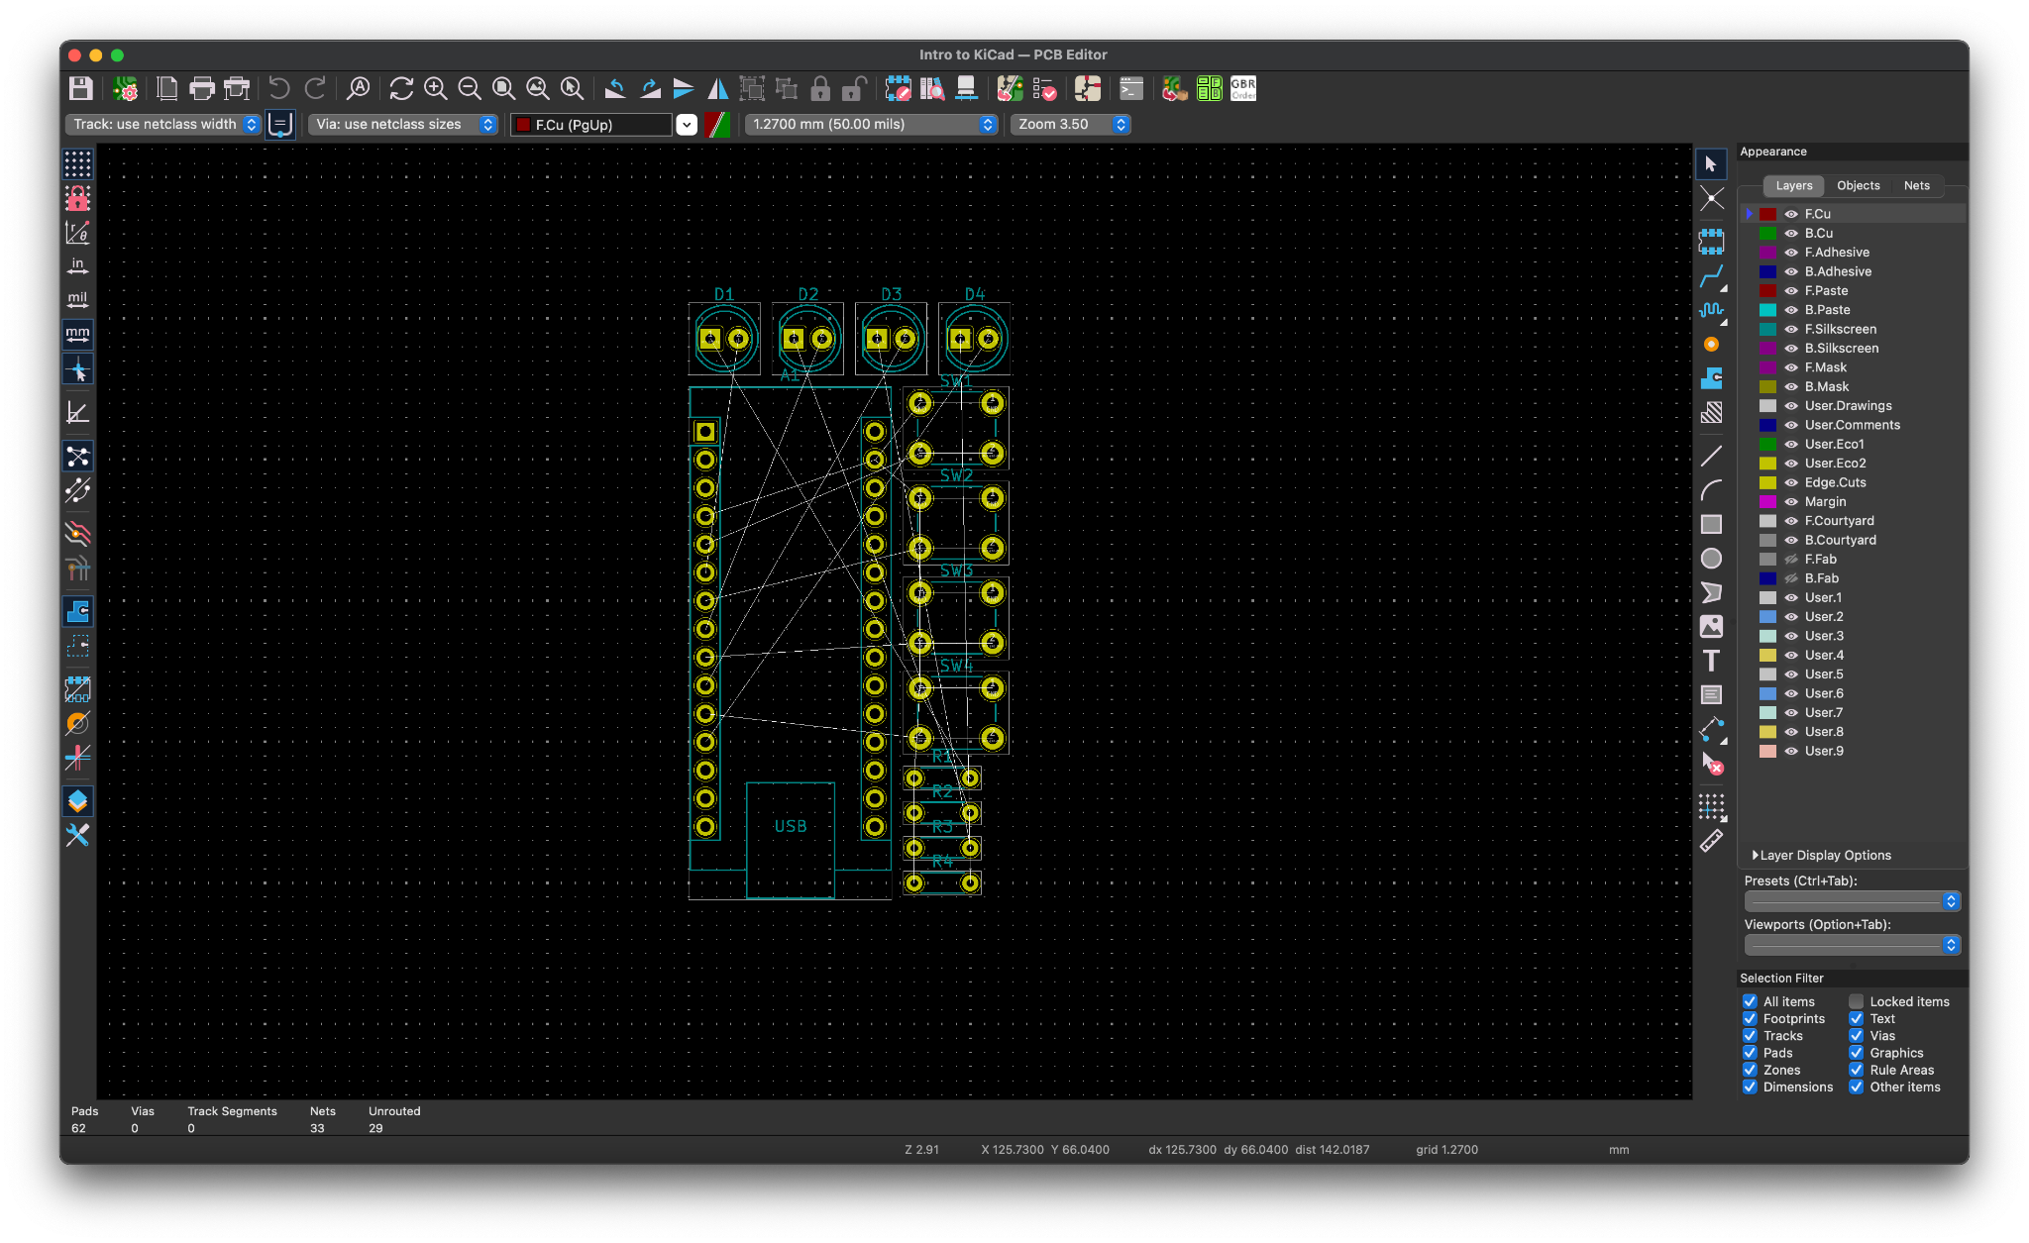
Creating your first PCB
Click the update PCB from Schematic button in the top toolbar to add all the assigned footprints from the schematic to the PCB

Slide 22
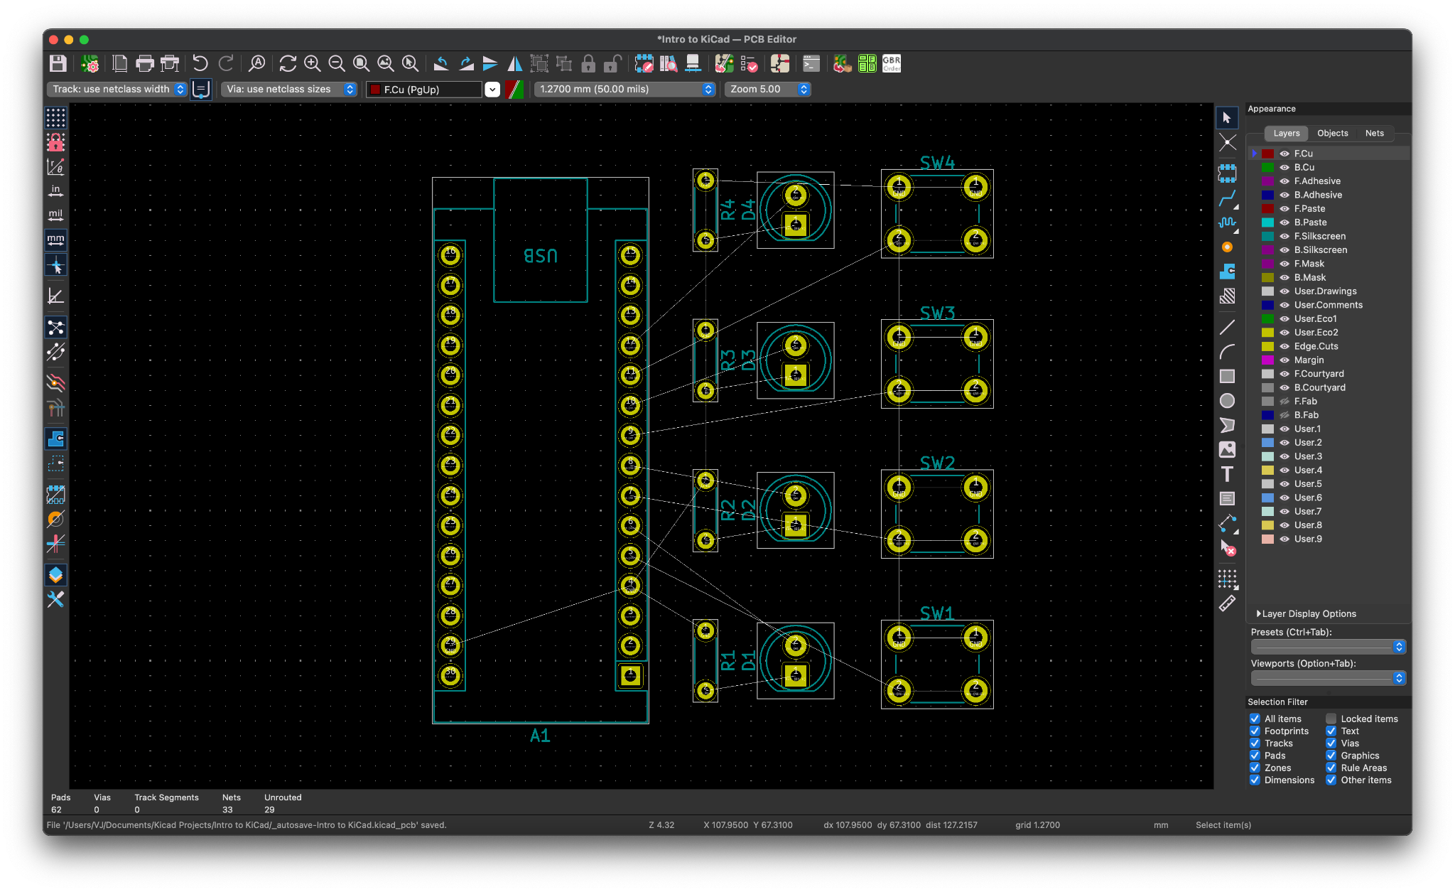
Arranging your first PCB
Click the footprints and Use the Move command (M) along with the Rotate command (R) to arrange the components on the PCB
If you aren’t sure about placement it can help to have a working breadboard already made that you can copy from

Slide 23
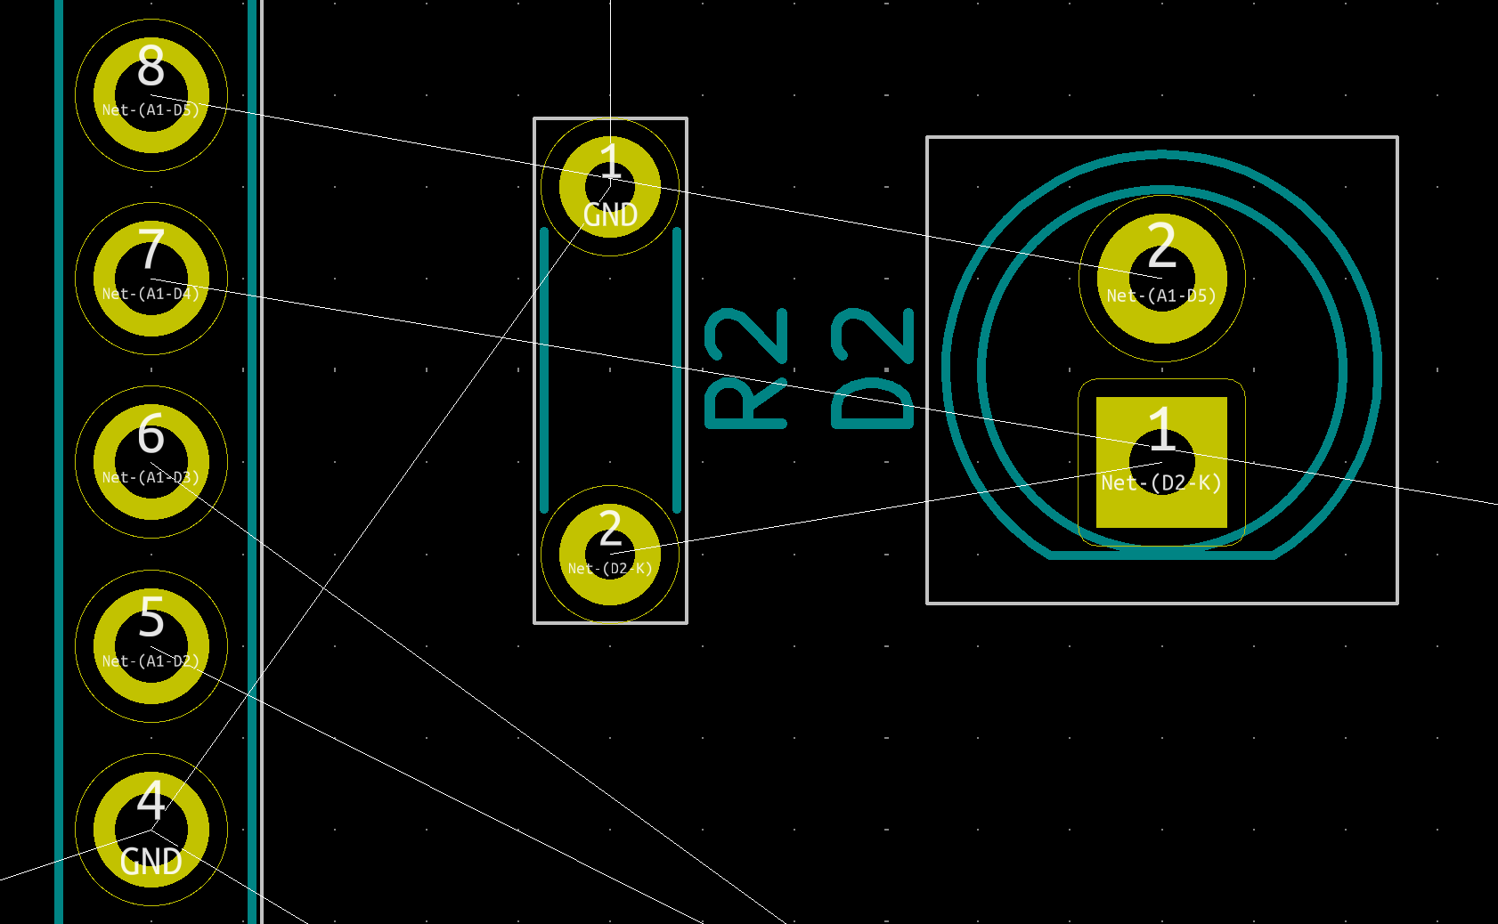
Wiring your first PCB
All the floating lines connecting the footprints together is known as a rats nest
These lines correspond to your schematic so you know where to place wires

Slide 24

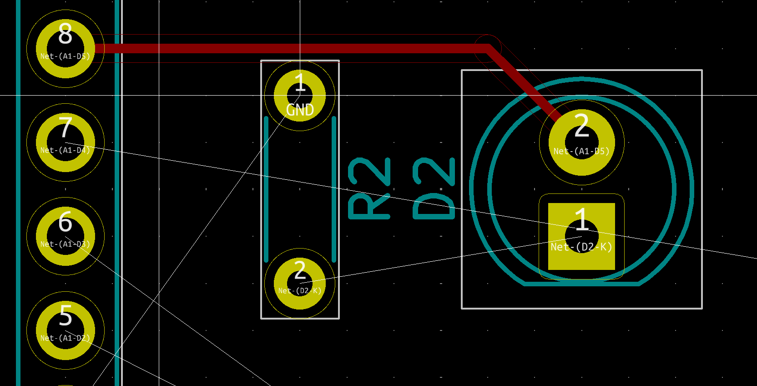
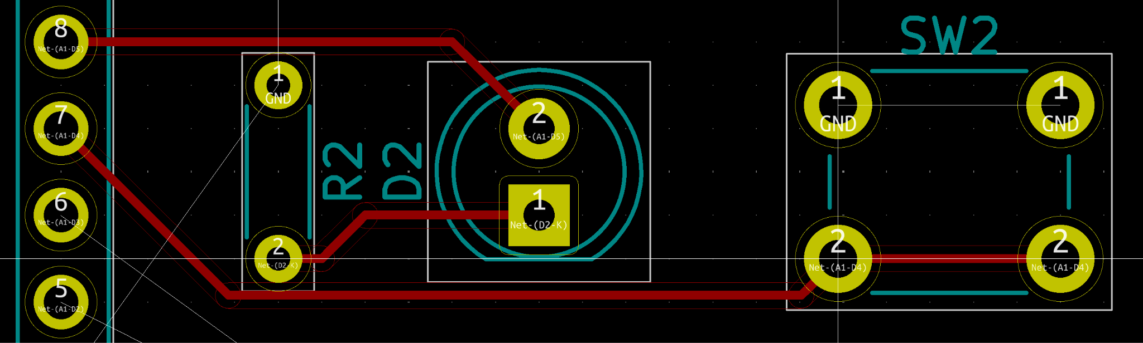
Wiring your first PCB
Use the Route Tracks tool (X) in the right toolbar to place wires
Click a pad with a rats nest to start routing it
As you route tracks you can use the autoroute shortcut (F) to help speed up placement
Save power and ground nets for last, you can hide them in the Nets tab on the right

Slide 25
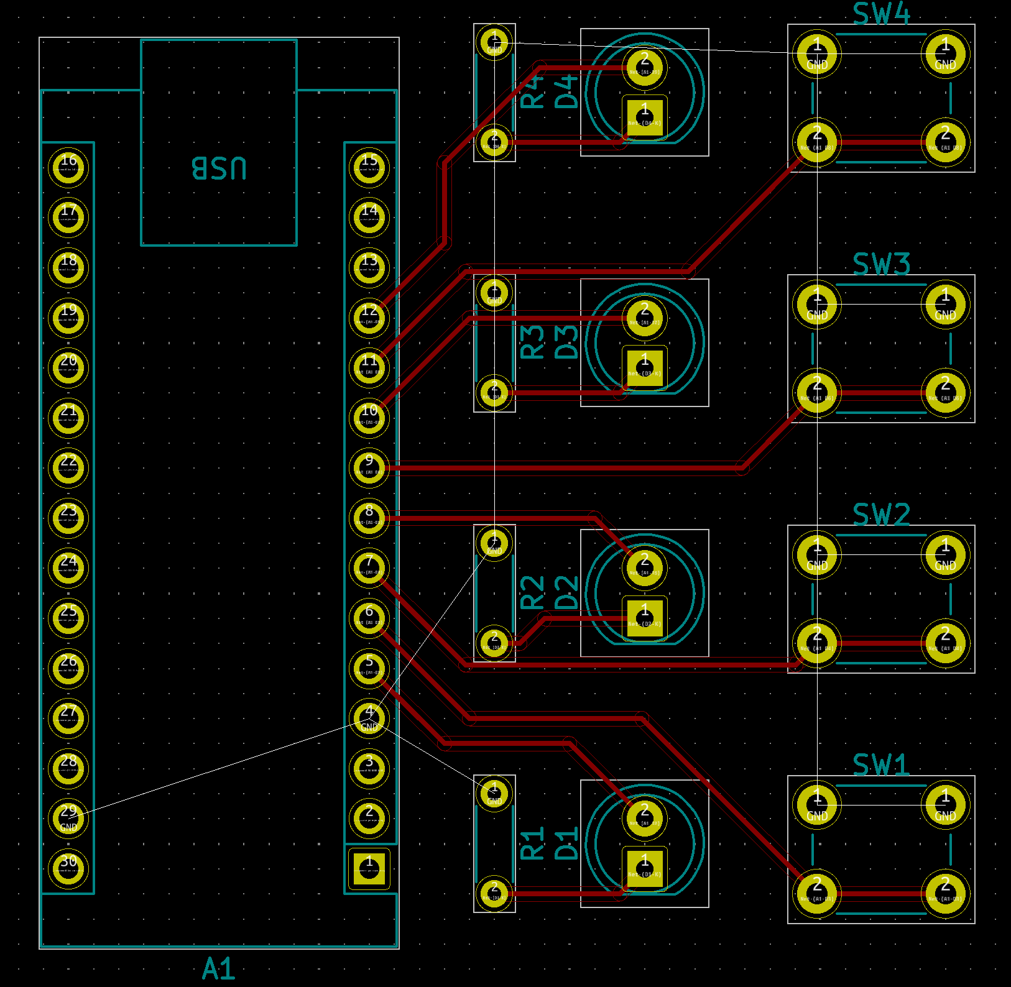
Sizing your first PCB
With most of the wiring now complete it’s important to make a board outline

Slide 26
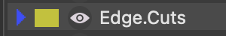

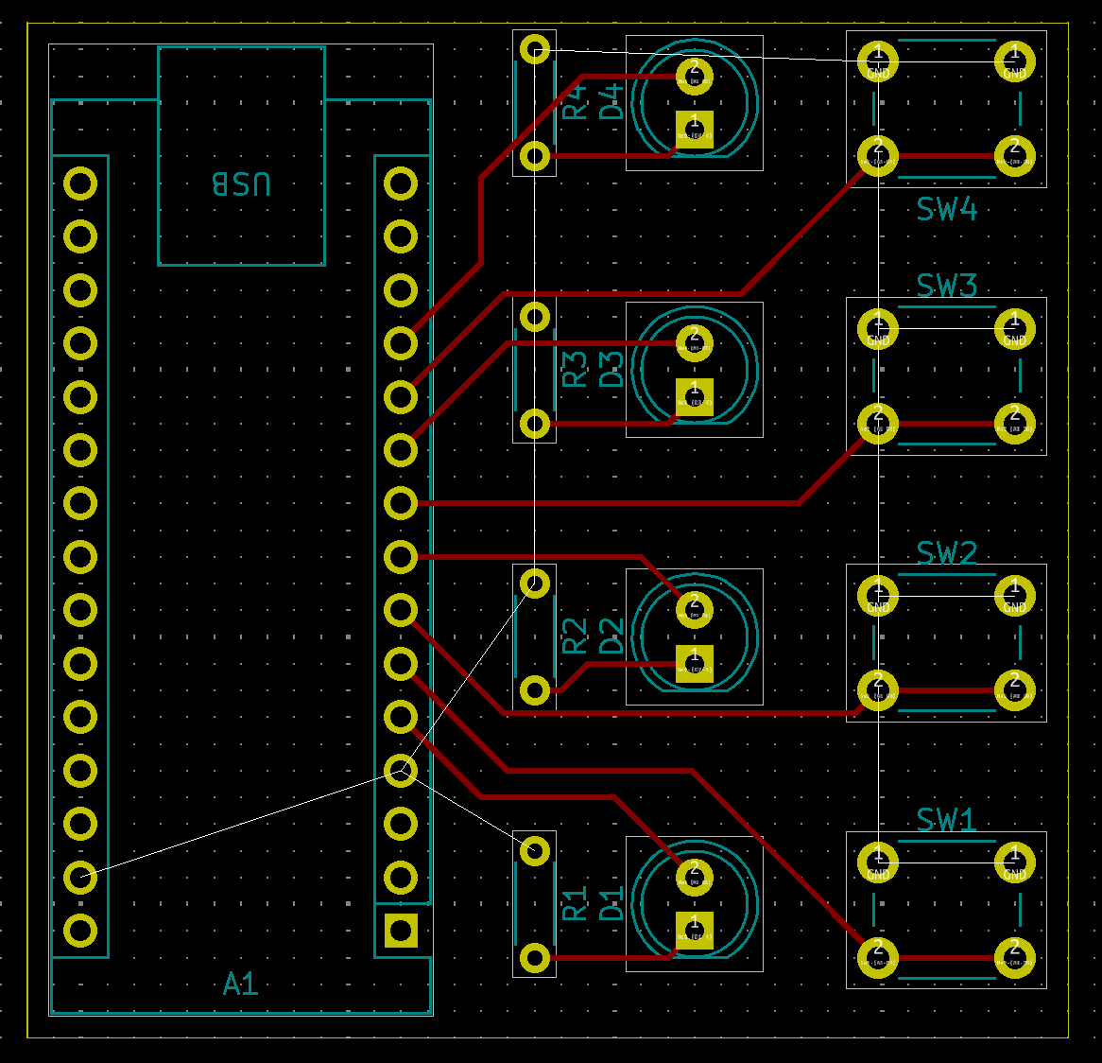
Sizing your first PCB
First select the Edge.Cuts layer from the Layers tab on the right
In that layer use the Draw Rectangle tool to draw an outline around your footprints

Slide 27


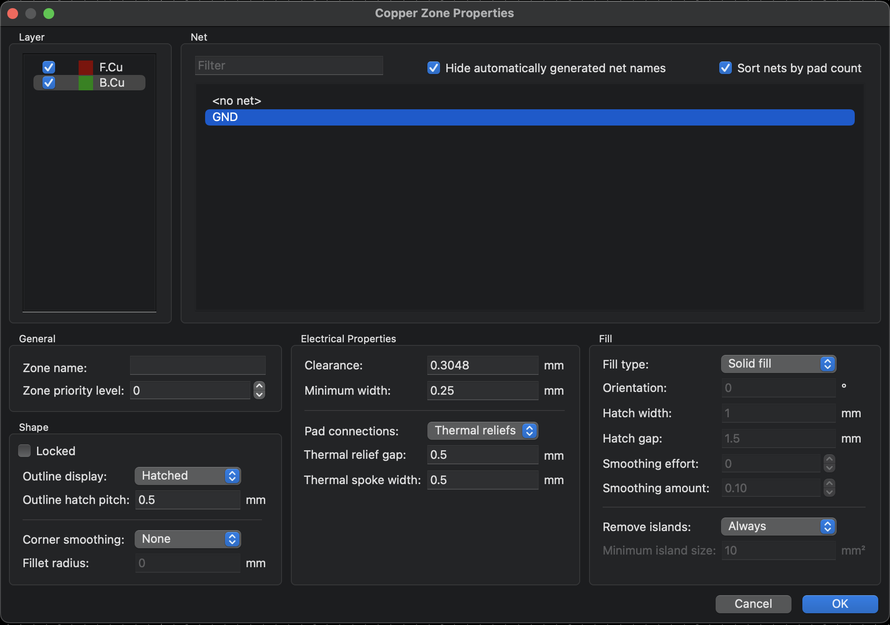
Wiring your first PCB
All we have left is ground so we can use a ground plane
Go back to the Front layer
Use the Add Filled Zone tool and place it in the corner of the board outline
Checkmark both Layers and select the GND net

Slide 28

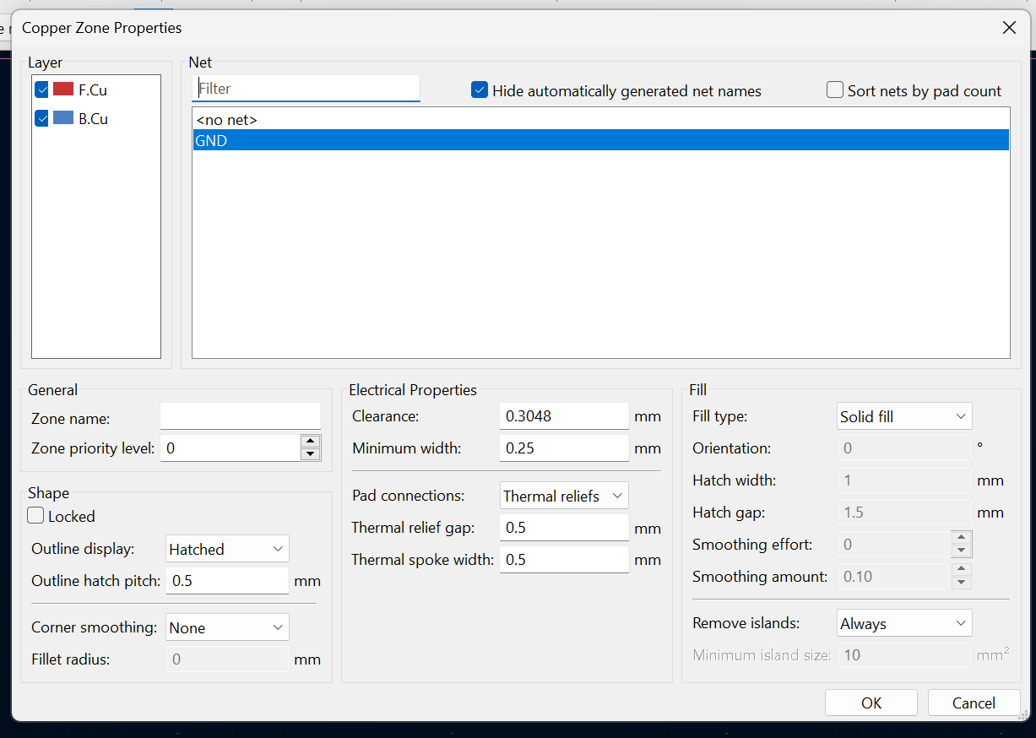
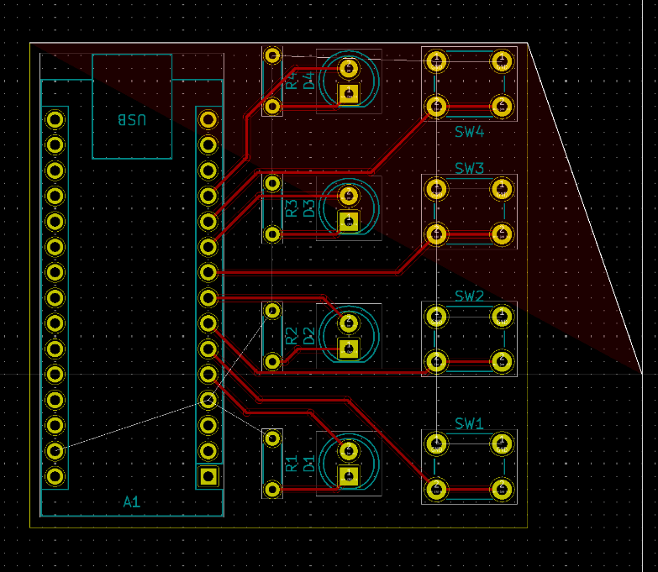
Wiring your first PCB
Once you click OK you can now place the outline of the ground plane, put it in the same place as the board outline

Slide 29
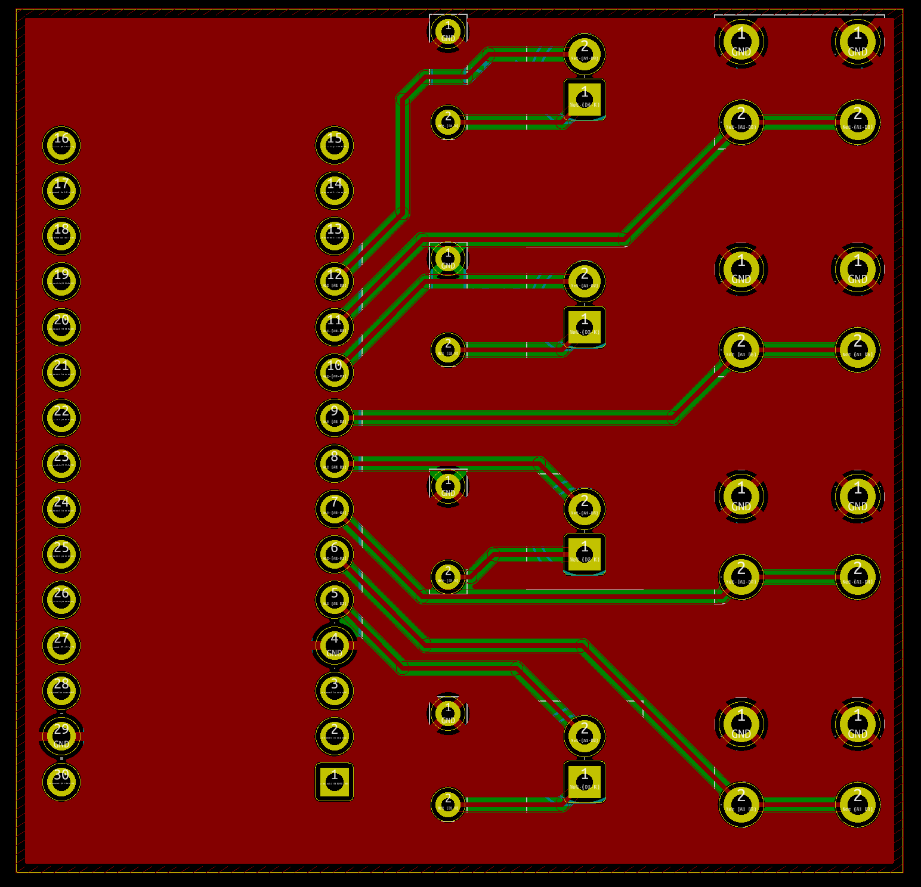
Wiring your first PCB
Now you use the Fill All Zones tool (B) to update your ground plane

Slide 30

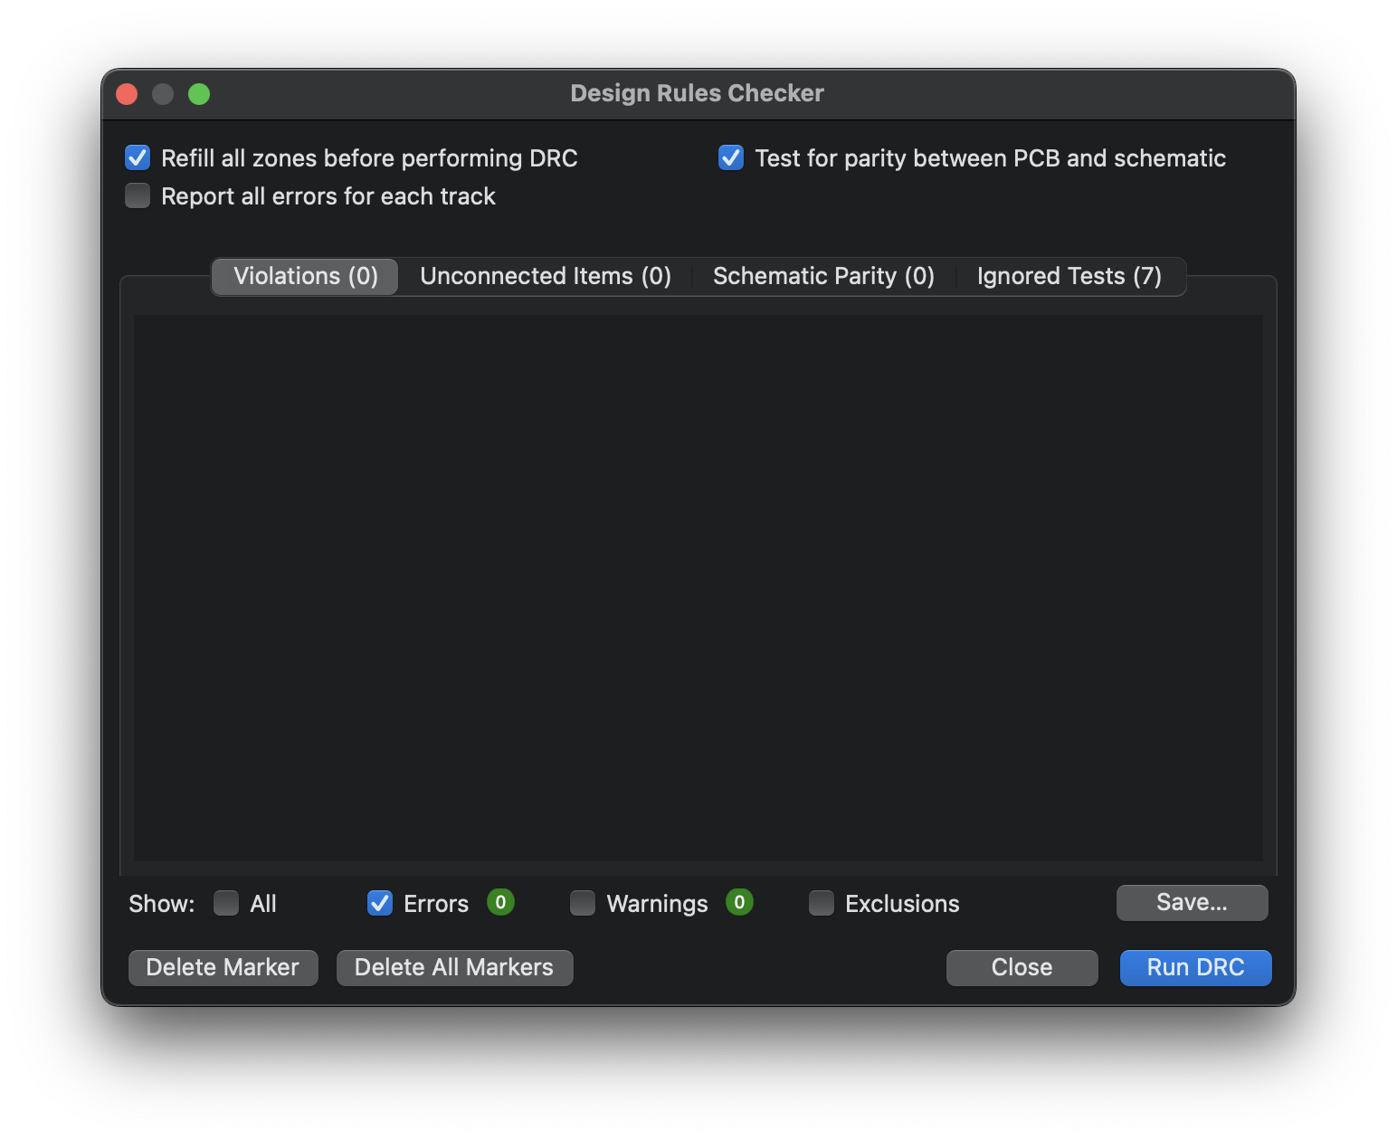
Verifying your first PCB
Use the Design Rules Checker in the top toolbar to check for any errors in your design
If no errors are present then your first PCB is complete

Slide 31

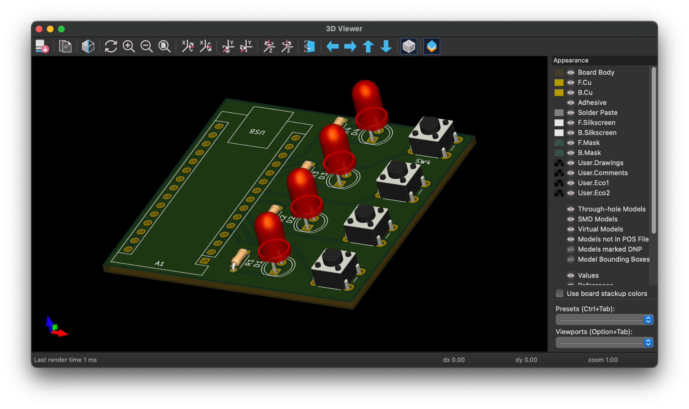
Viewing your first PCB
In the PCB Editor use the 3D Viewer tool (Alt+3) in the top toolbar to see a preview of your PCB

Slide 32
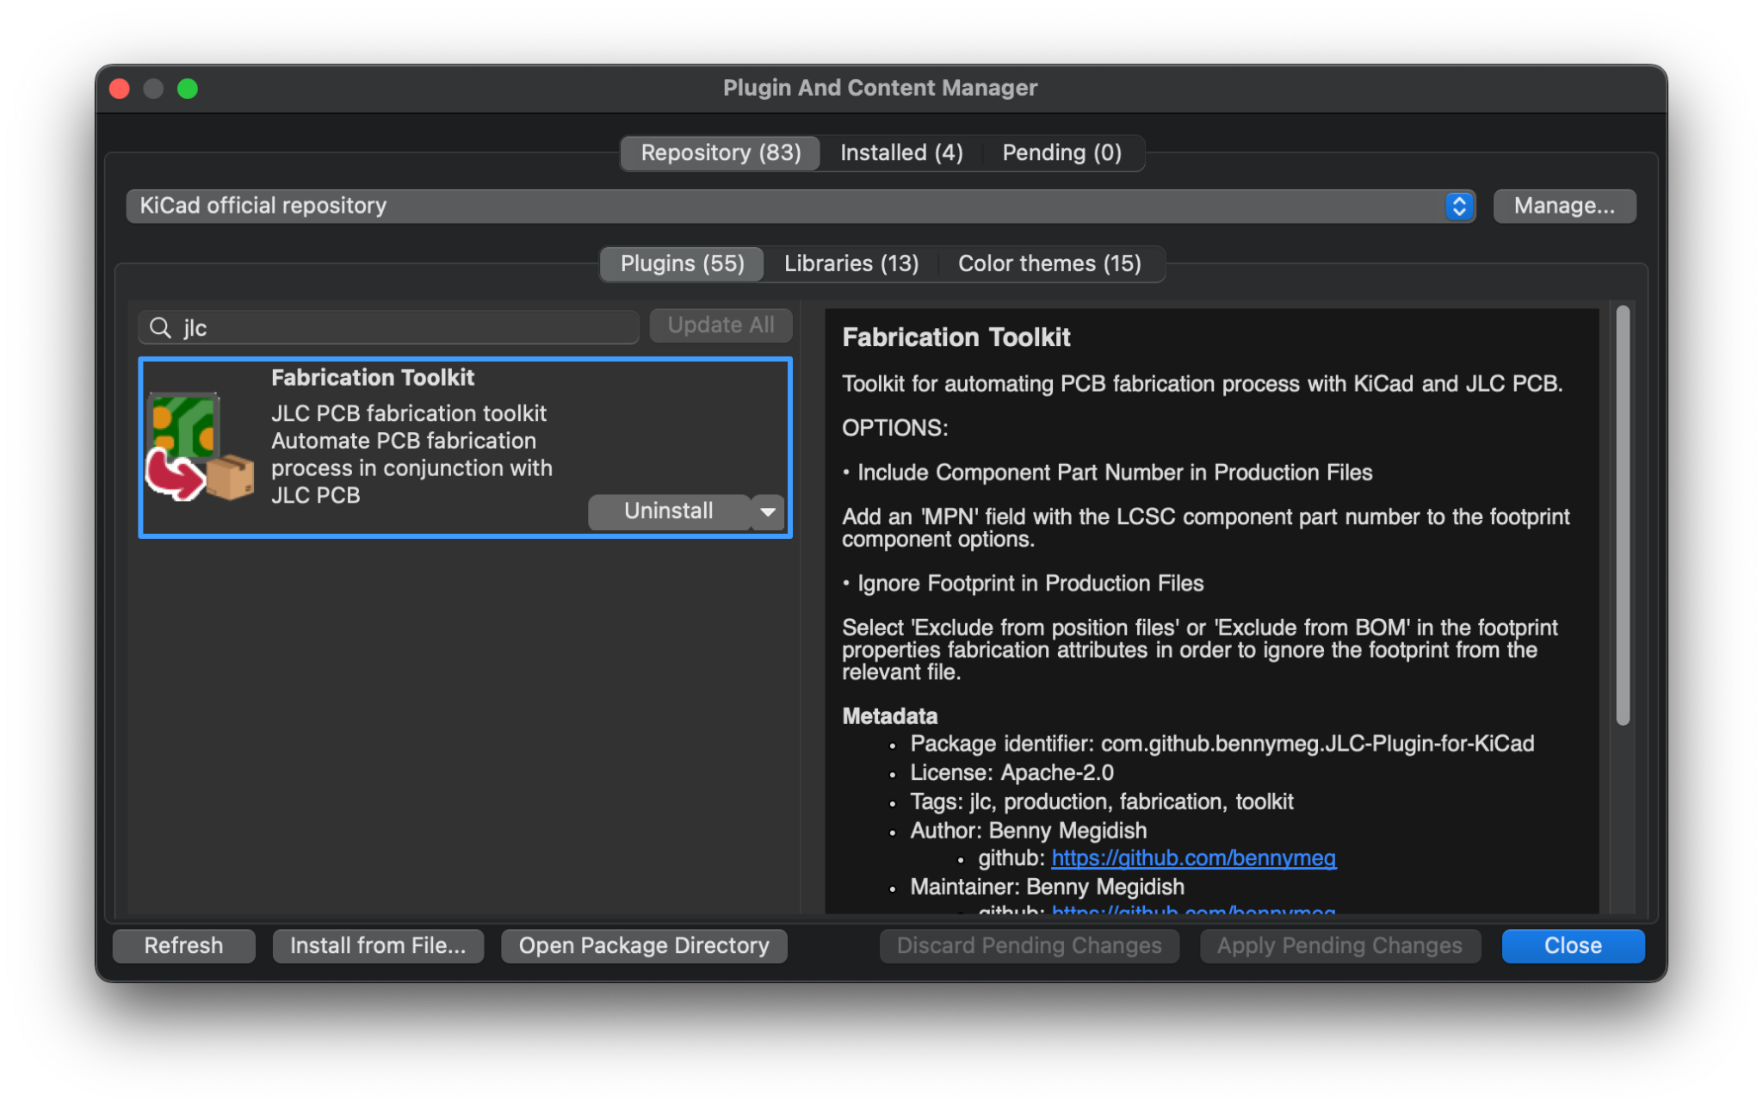
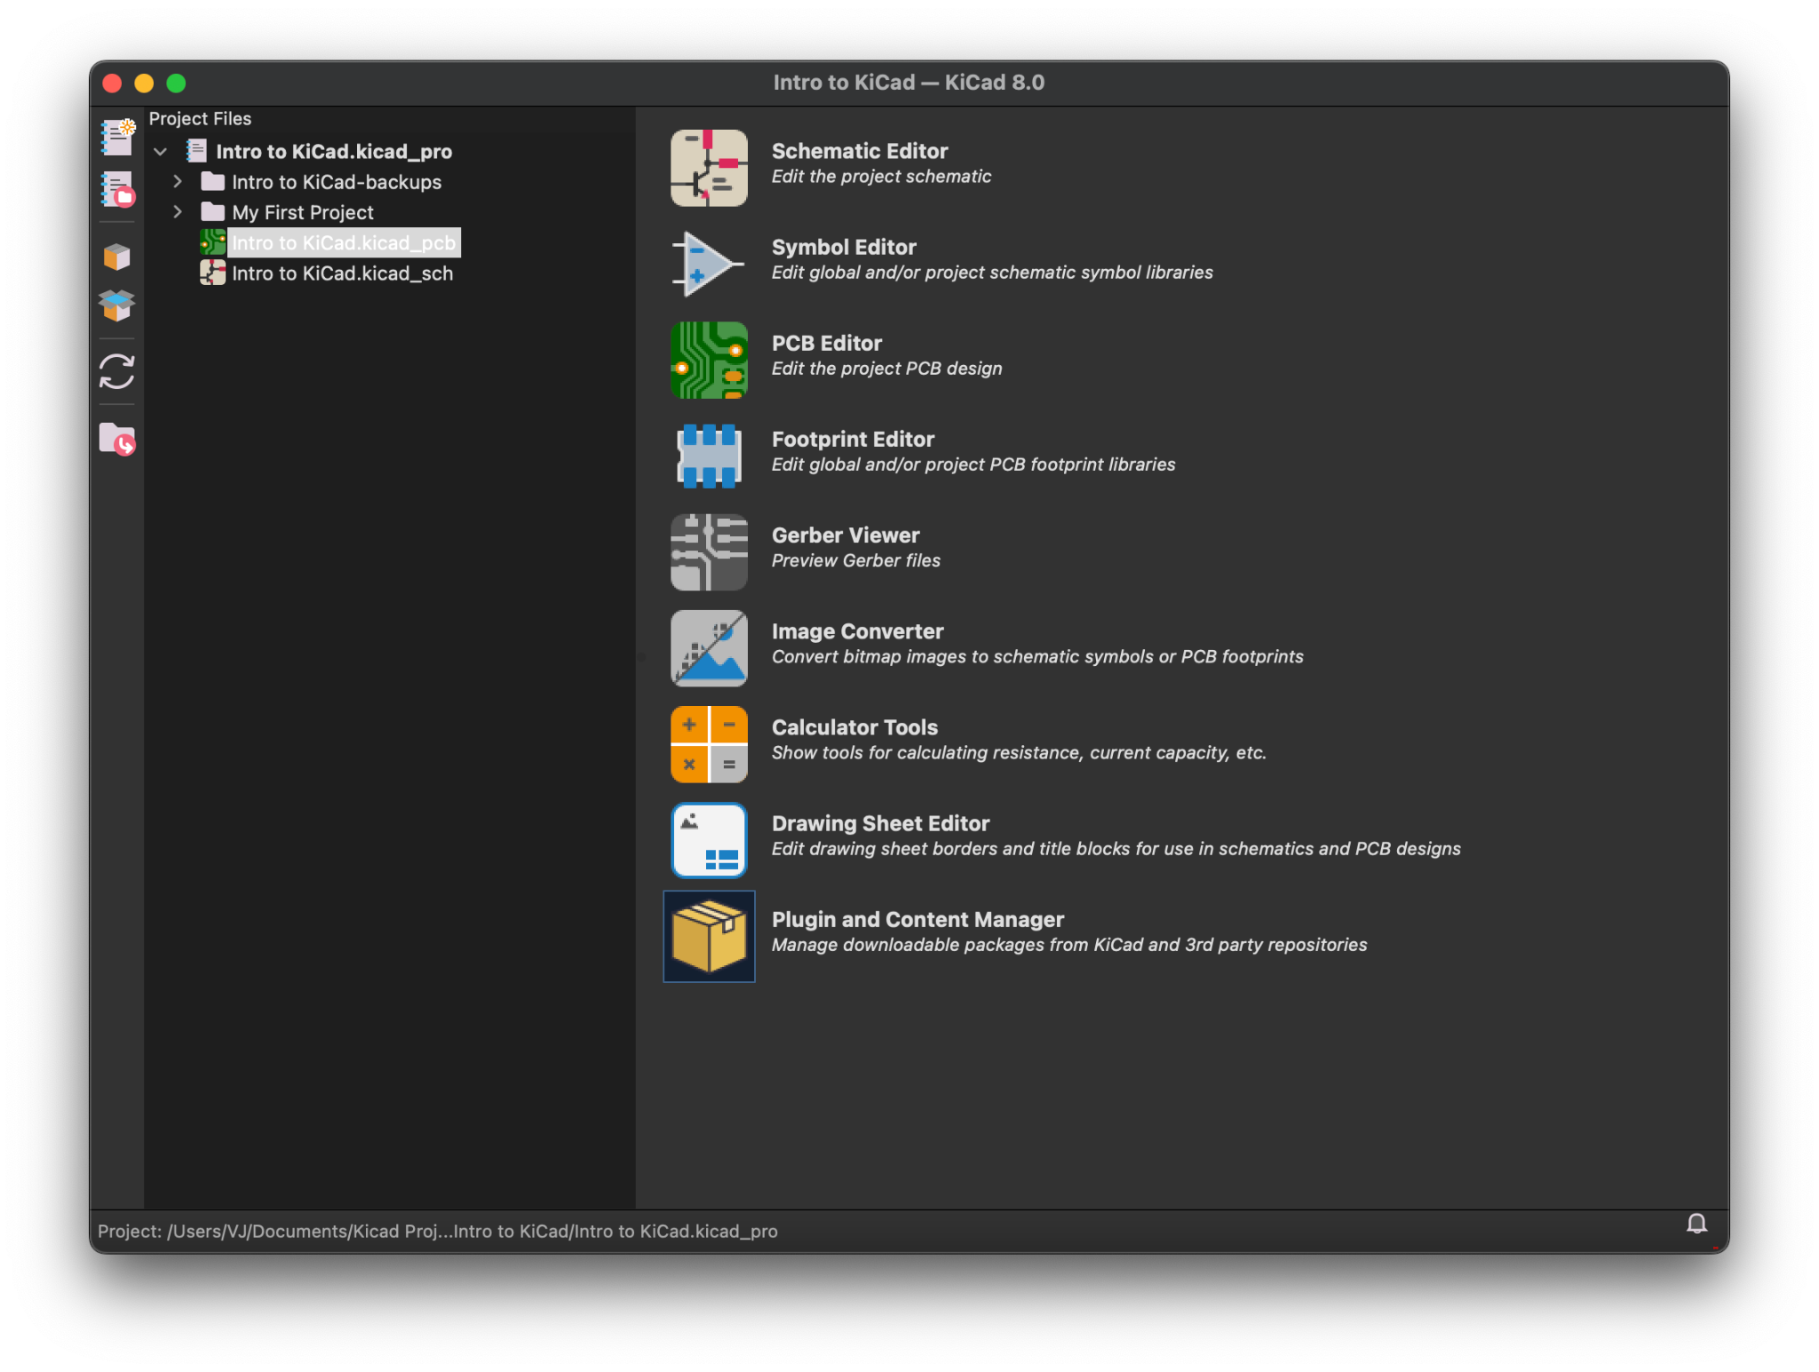
Exporting your first PCB
In the Project Manager window click Plugin and Content Manager
Search for jlc and install Fabrication Toolkit

Slide 33

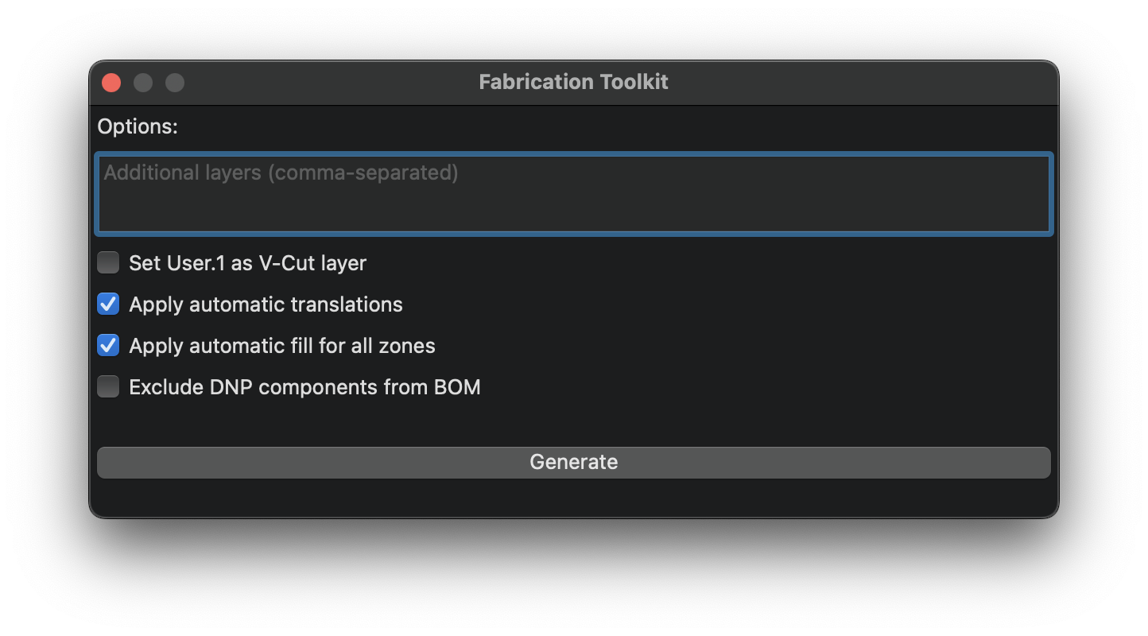
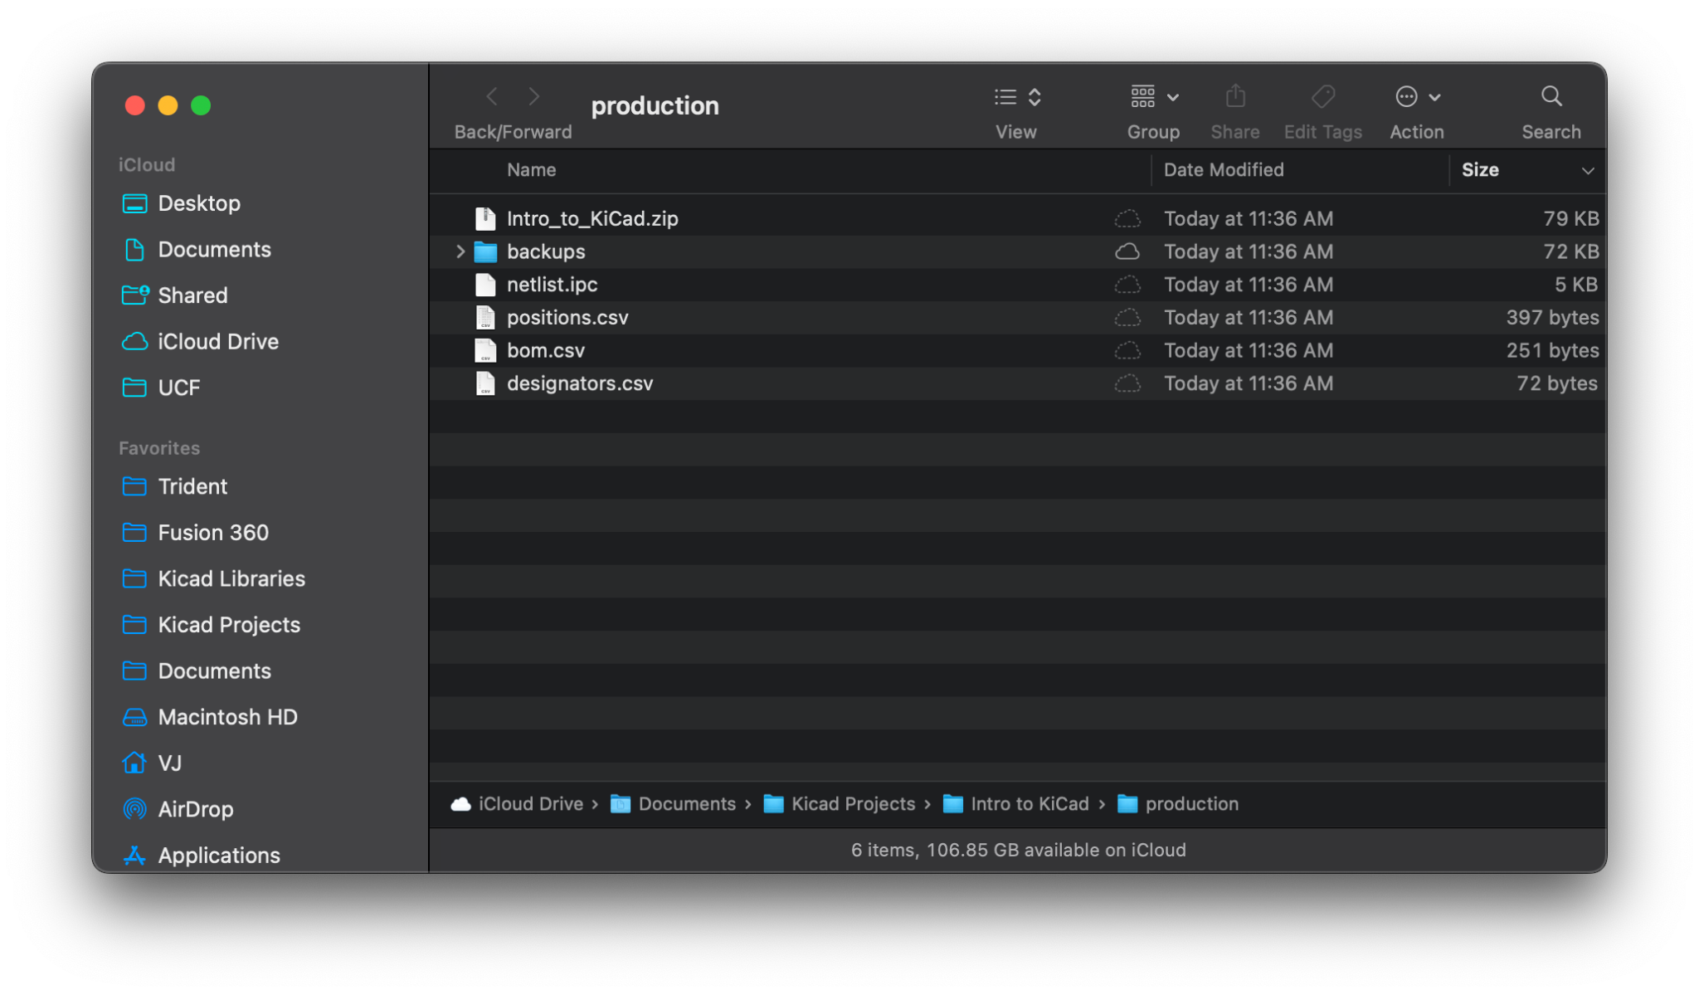
Exporting your first PCB
In the PCB Editor click the Fabrication Toolkit icon in the top toolbar and click generate
Once complete the folder with the production files will open automatically

Slide 34

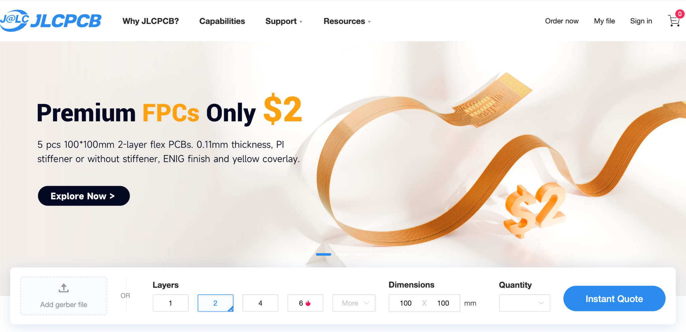
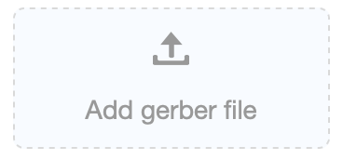
Ordering your first PCB
Navigate to https://jlcpcb.com
Drag & Drop the zip file in the production folder onto the Add gerber file box in the website

Slide 35
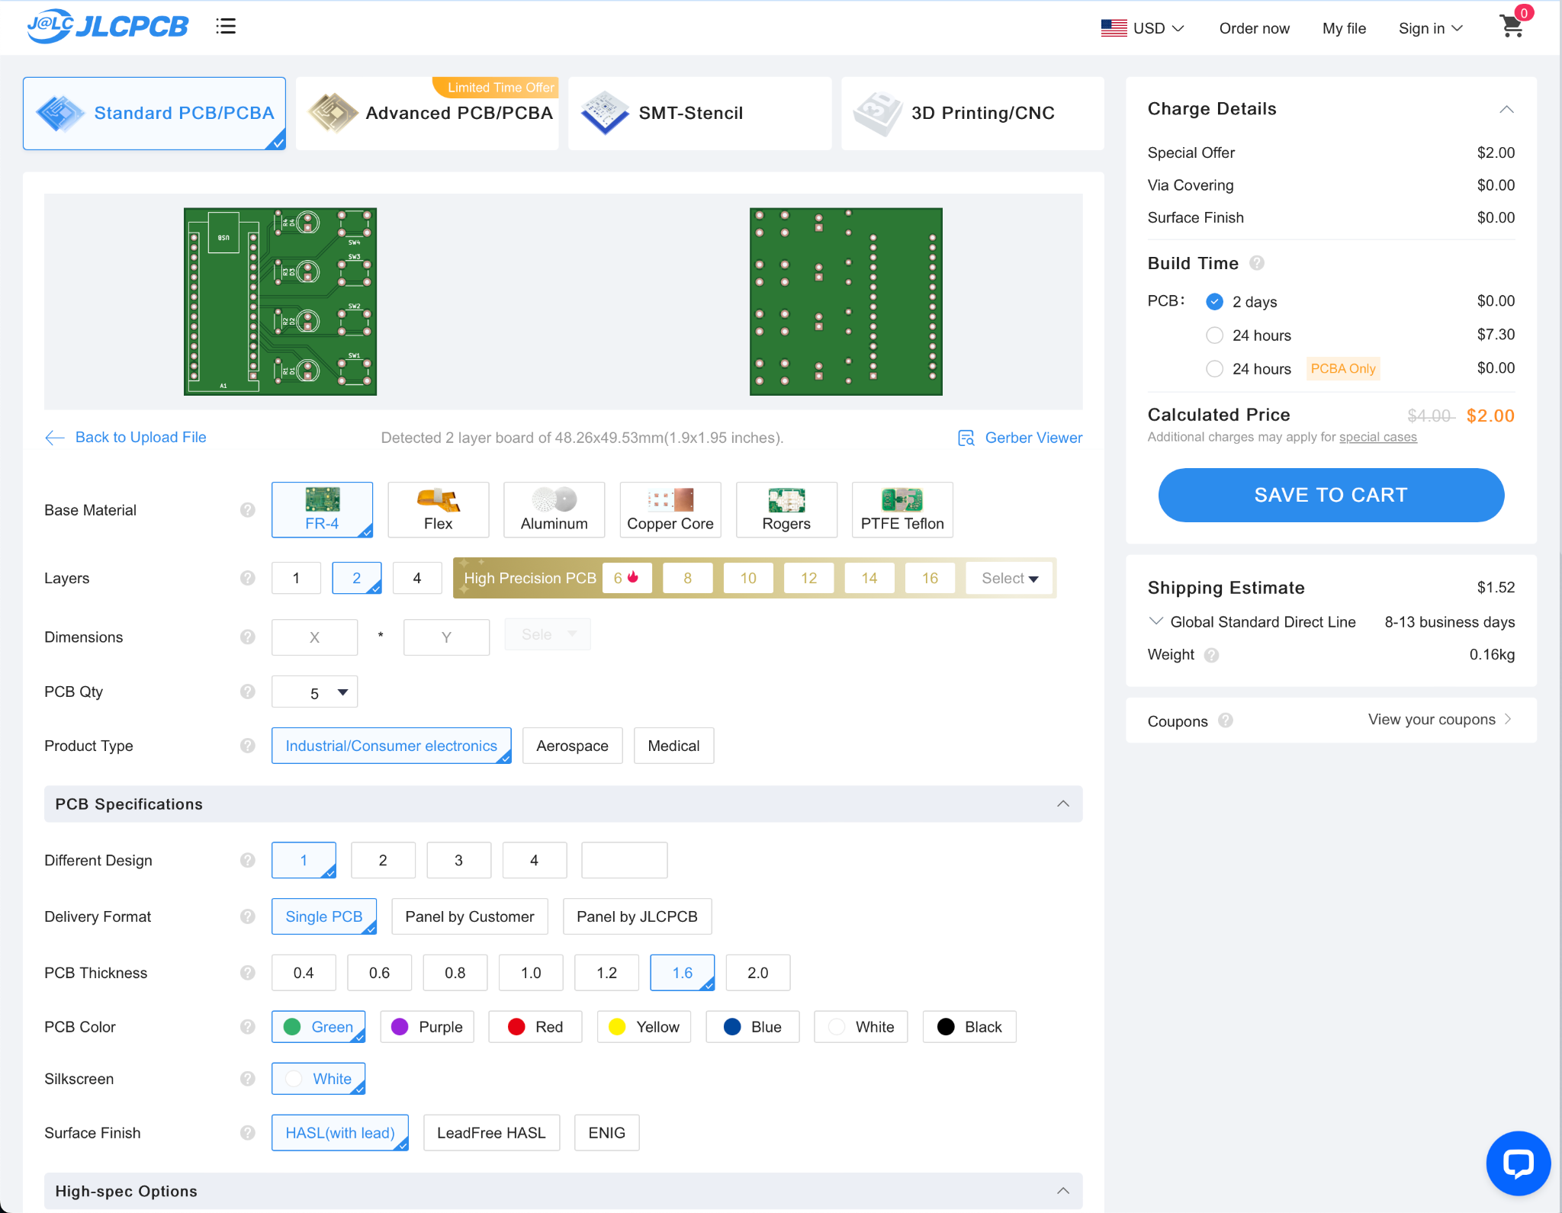
Ordering your first PCB
Congratulations! You can now order your first PCB

Slide 36
Timeline and Important Dates
Weekly Meetings - Estimated Timeline
Week 1 | Week 2 | Week 3 | Week 4 | Week 5 | Week 6 | WEEK 7 | WEEK 8
Introduction | Microcontrollers - Erik | Fusion 360/Solidworks - Matias | KiCAD -Tino | Soldering/Prototyping/General Project Management Skills/ Github | BOM Development Workshop | BOM DUE - Technical Assistance Workshop | Technical Assistance Workshop - Progress Checks

Slide 37
Reminders
Please check discord channels for your respective project.
Recruit if you want! The more the more you may learn and get out of the project!
Next week soldering workshop/prototype development/project development/github. Applying our skills we learned!

